Slide 1

SISSO (sure-independence screening and sparsifying operator)

Slide 2
Overview of sisso
Regressor technique which yields predictive surrogate models expressed as analytical formula.
Used in conjunction with compressed sensing techniques to filter features.(OMP)
Overcomes limitation of smaller datasets.

Slide 3
main Parameters
OMP(Orthogonal Matching Pursuit) – Selects features of data set to be used based off their coefficients. Number of features can be specified.
Operation set – Specifies possible operations to be used. E.g "(+)(*)(^2)(^3)(^-1)(cos)(sin)“.
Descriptor dimension/rung/complexity – Specifies number of features, composed operations and operations used.
SISSO then selects model which yields lowest RMSE after specifying parameters.

Slide 4
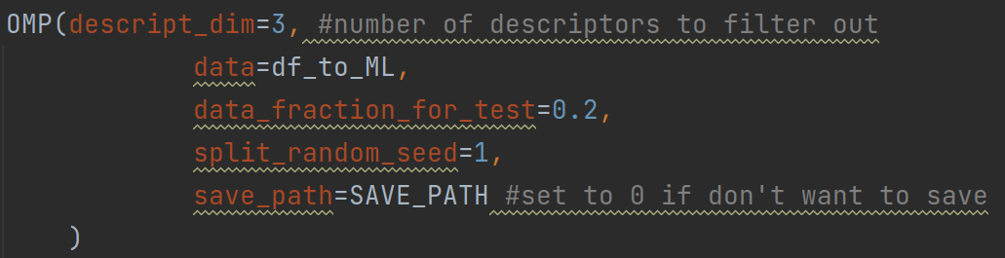
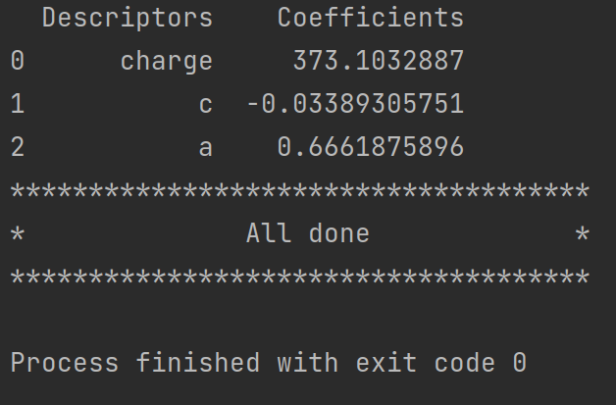
OMP Demo
Applied to Mxenes dataset.
Input:
Results:
3 most correlated descriptors are found with their respective coefficients.

Slide 5
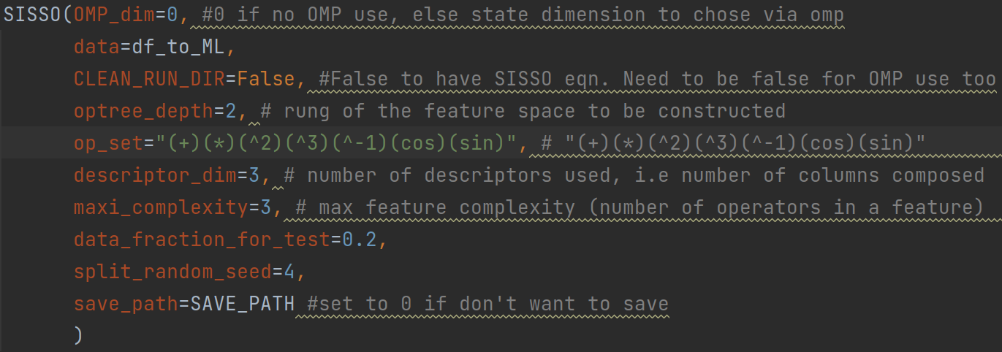
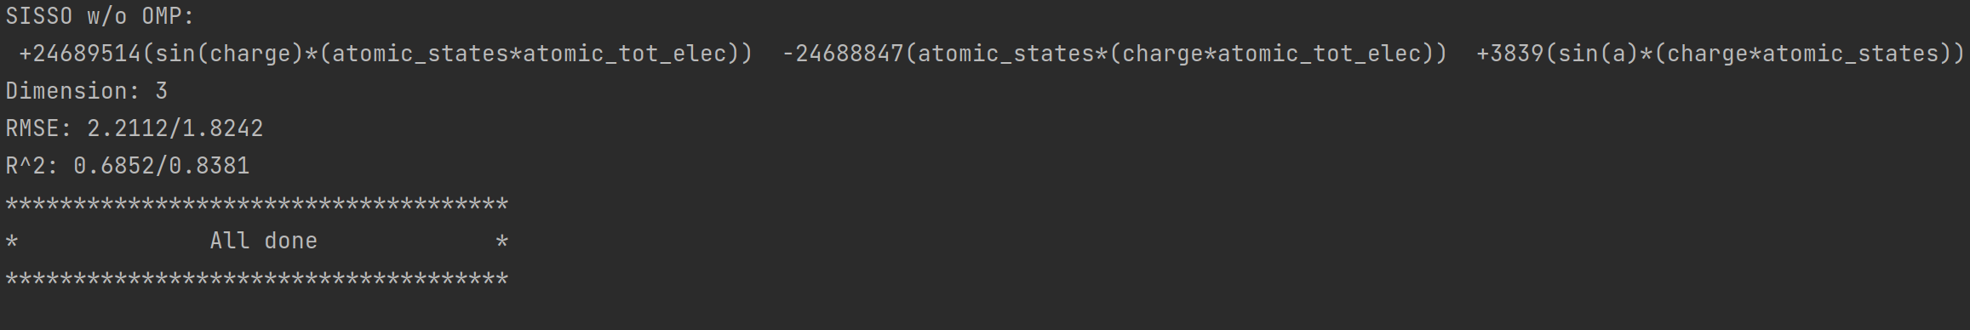
SISSO Demo
Applied to Mxenes dataset.
Input:
Results:
Analytic equation is obtained with dimension, RMSE and R-squared values.

Slide 6
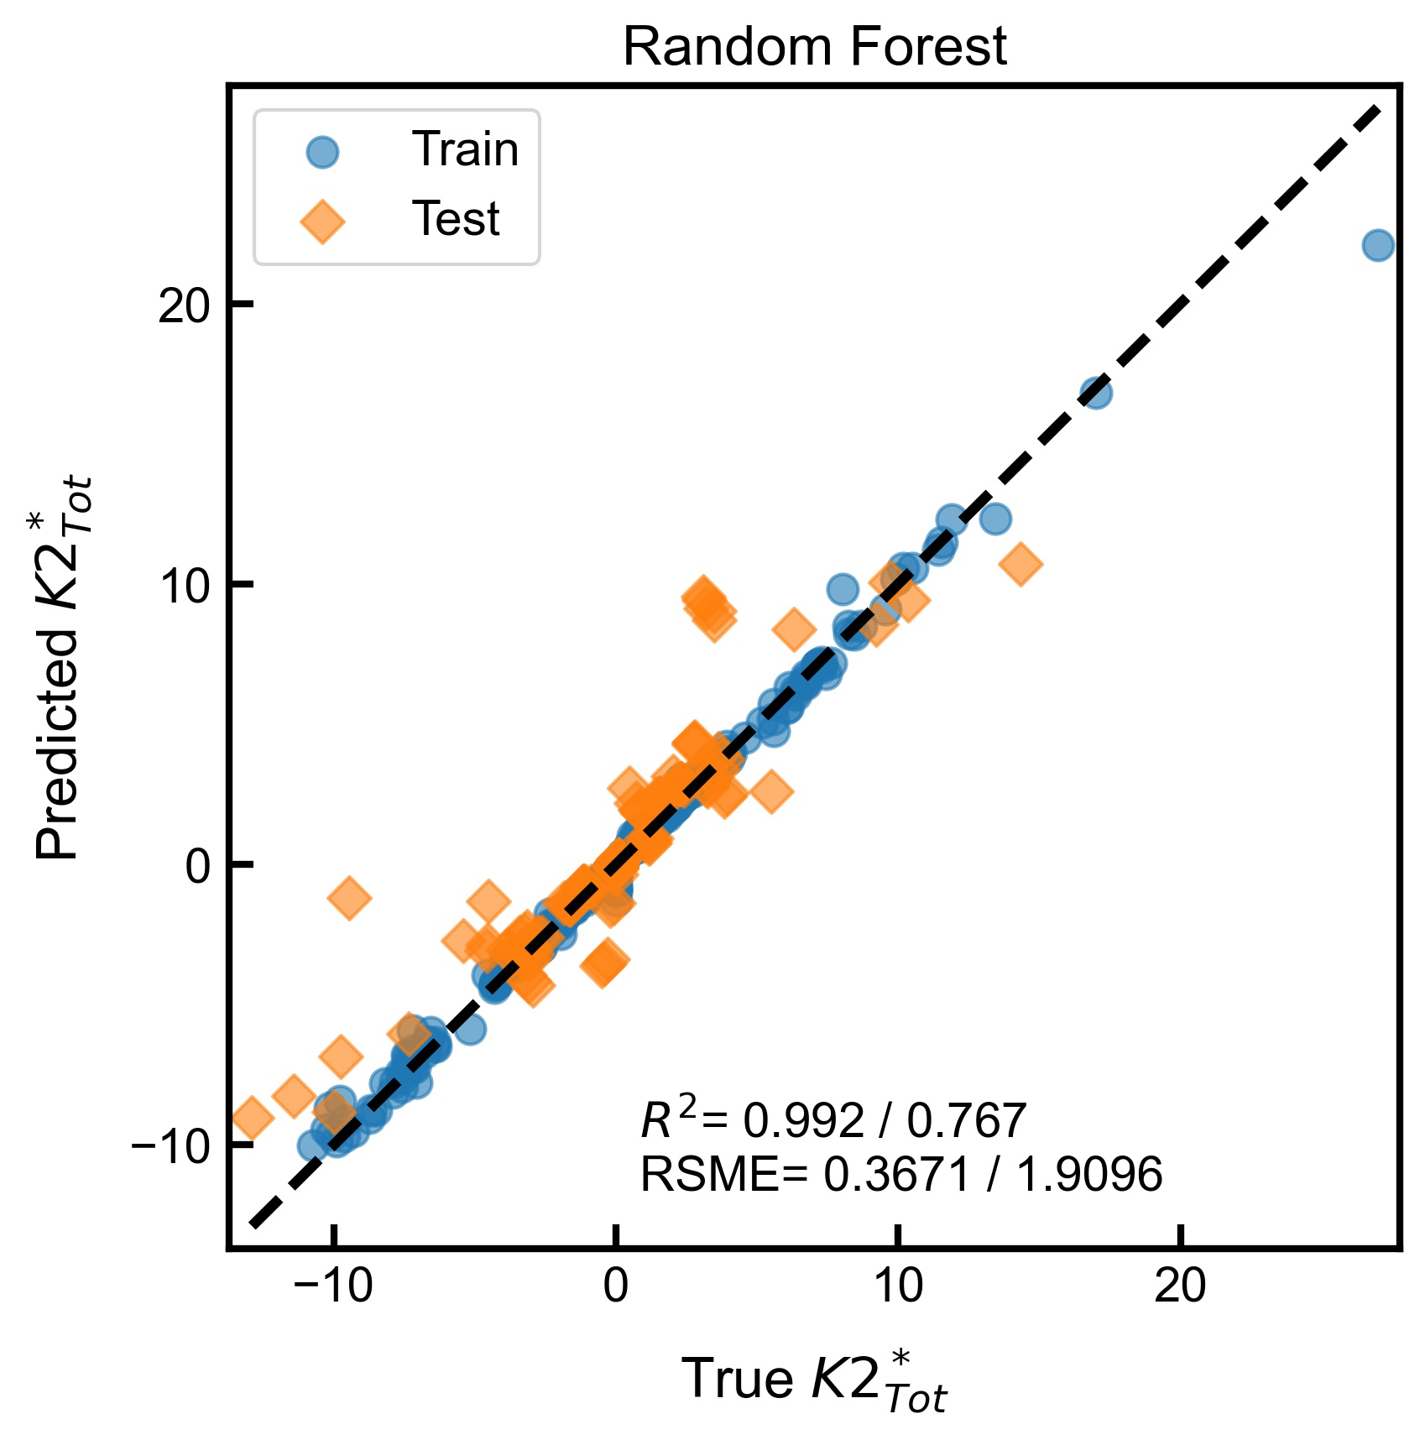
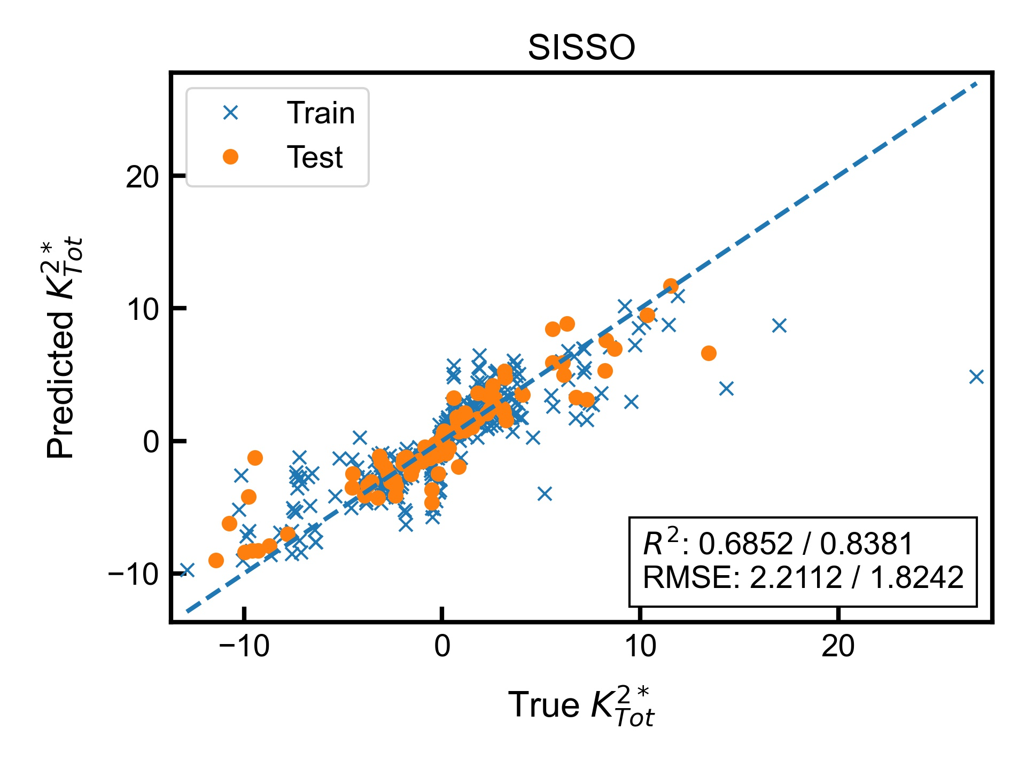
Comparison with general ml
Applied to Mxenes dataset.
Plots:
Performance is comparable, while attaining an analytic equation.

Slide 7
SISSO performance and results analysis

Slide 8
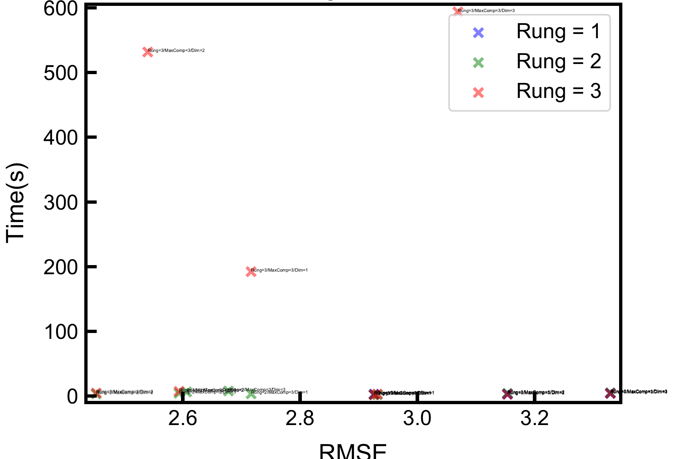
Performance plot
Applied to Mxenes dataset with target variable $K_{Tot}^{2∗}$
Points with varied parameters are plotted.(Rung, Maximum complexity, Dimension)
Observed that rung = 3 (red) is not necessarily more optimal for accuracy or time as points are distributed evenly. (potentially overfitting)
Observed that rung = 1 (blue) is less accurate as is distributed towards bottom right.

Slide 9
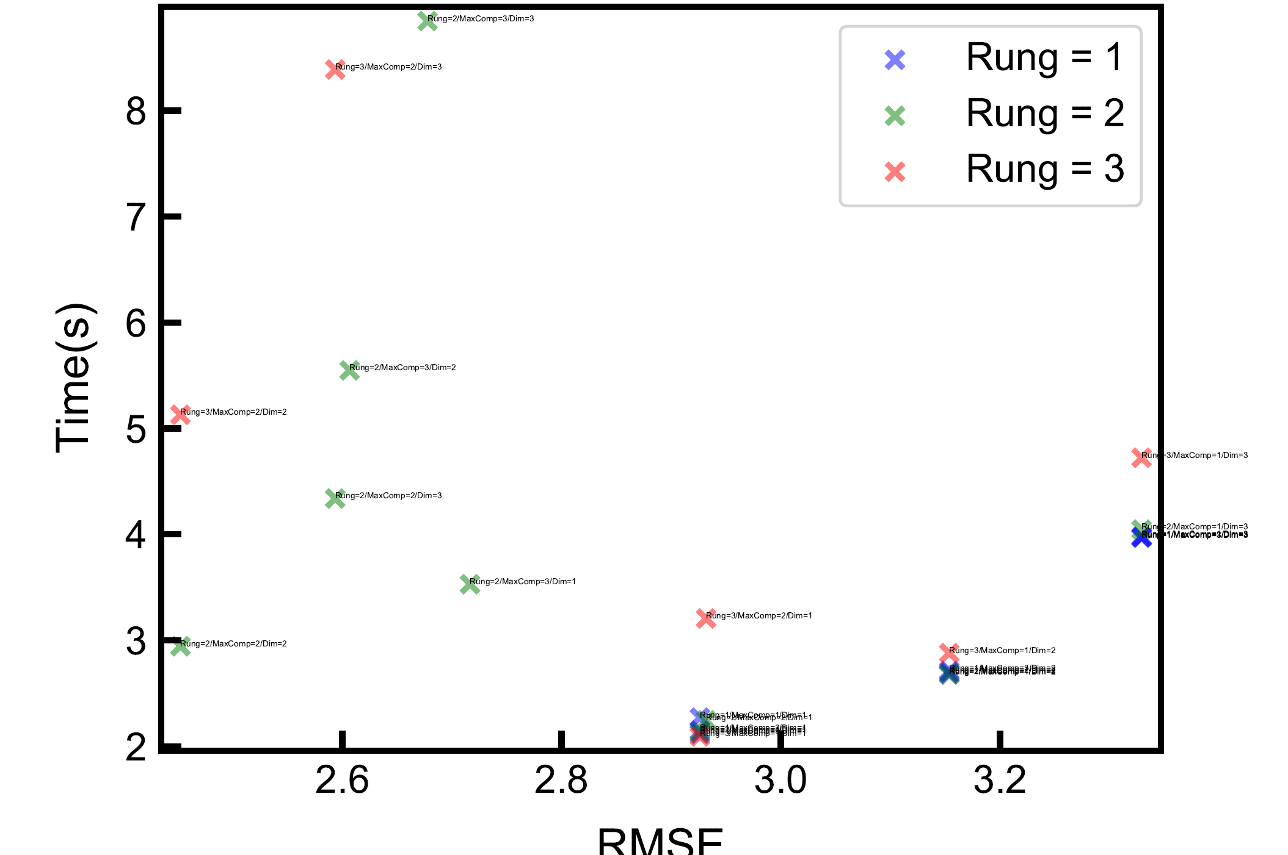
Performance plot (zoomed)
Zoomed into bottom portion of previous plot
Observed that rung = 2 (green) is optimal for both time and precision on mxenes dataset.
Best performance is observed with parameters rung, maximum complexity and dimension = 2. (Bottom left)

Slide 10
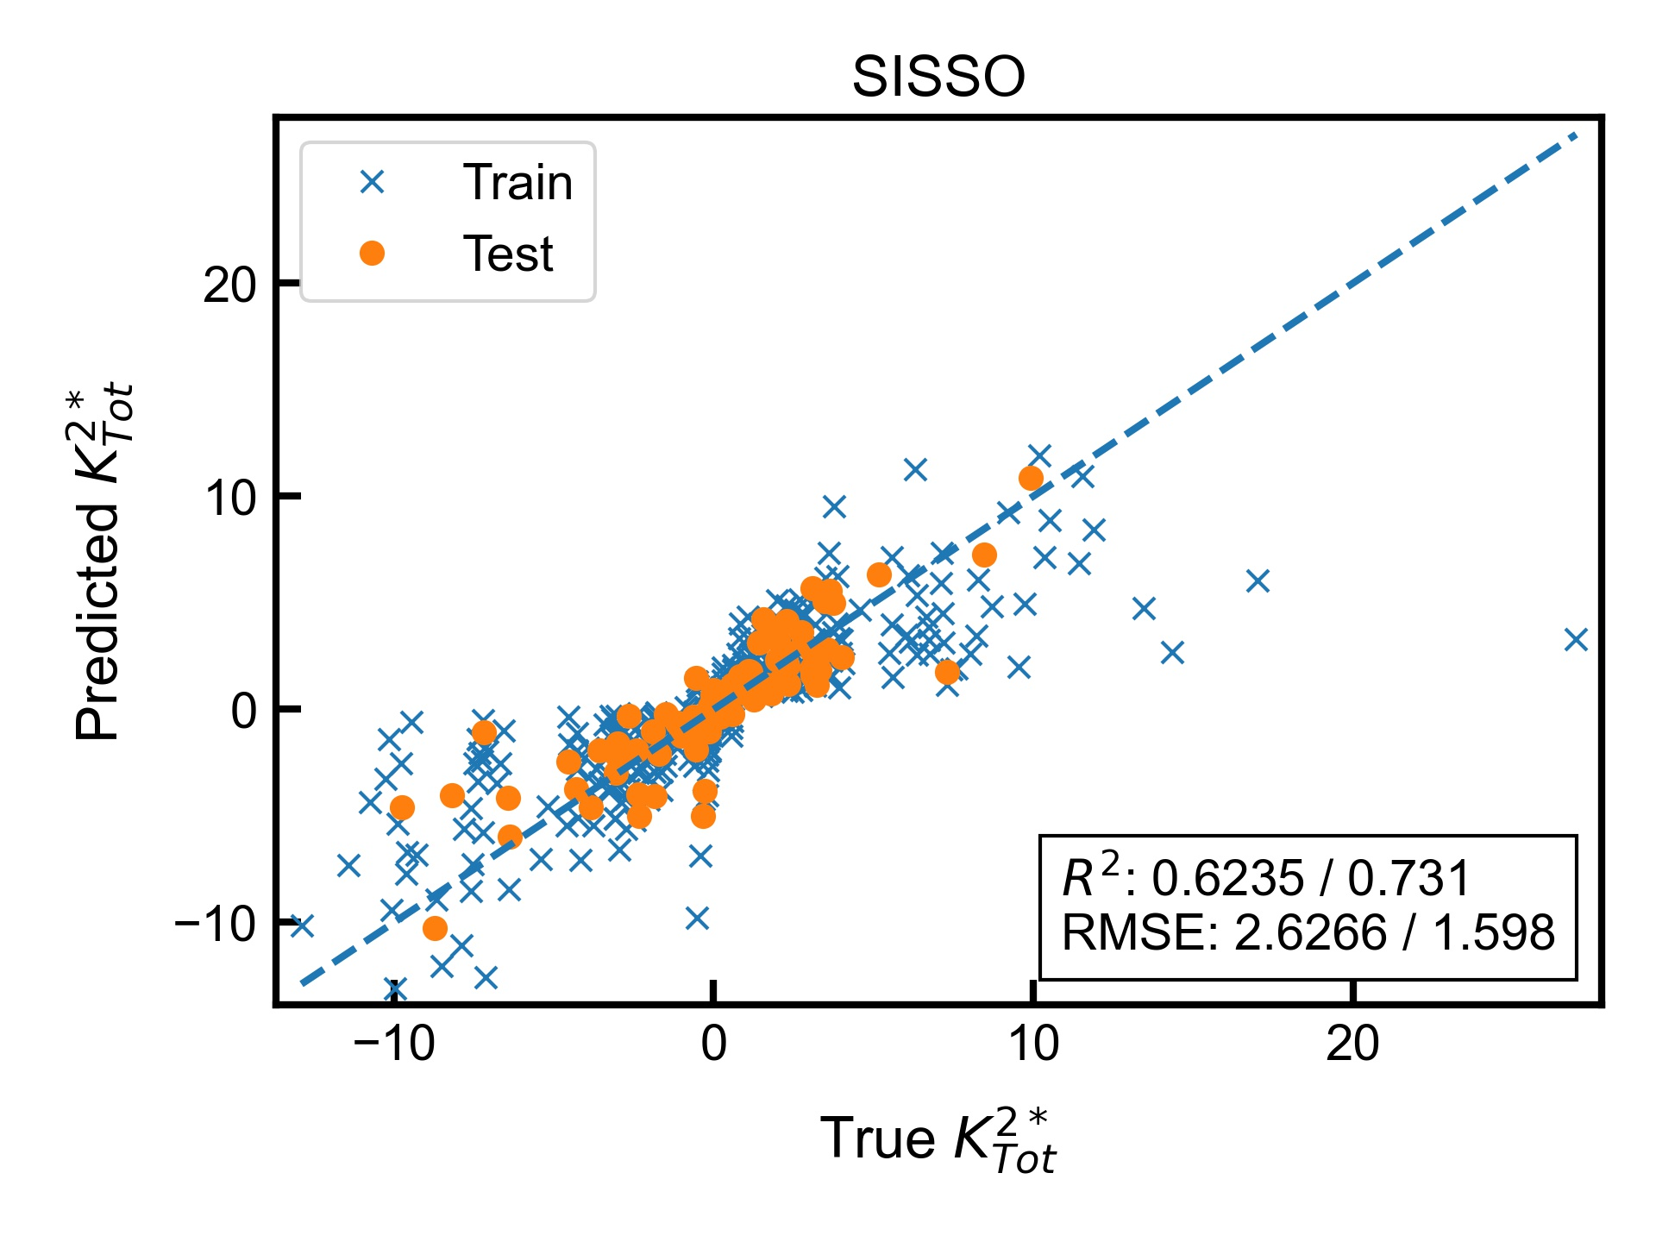
Application to mxenes data($K_{Tot}^{2∗}$)
Applied best parameters from analysis (previous slide) to $K_{Tot}^{2∗}$.
Accuracy is high
Analytic Equation: $6308.041021\left[atomicstates∗\left(charge∗totelecpervolume\right)\right]−8.738623357[\left(c33∗charge\right)∗atomicstates]$

Slide 11
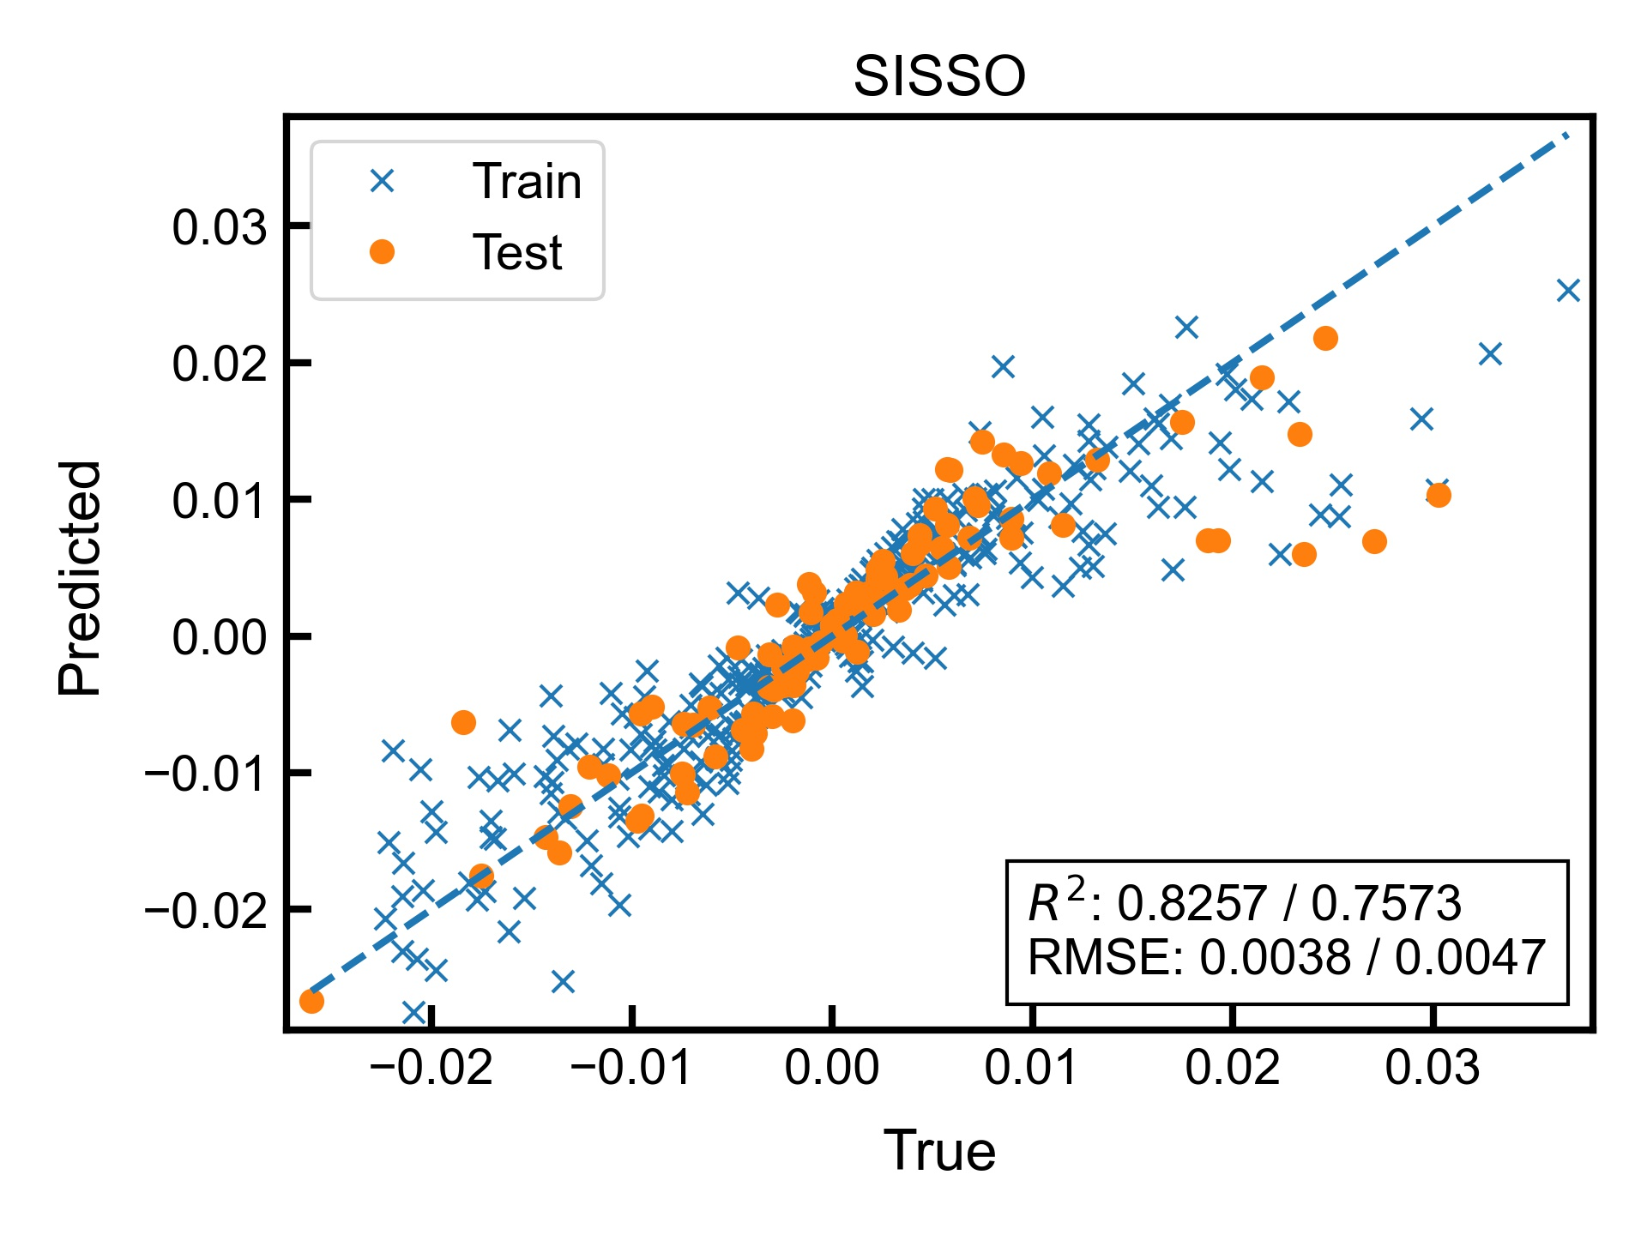
Application to mxenes data(Efficiency)
Applied same parameters to predict effitotsigned. (rung,maxcomp,dim = 2)
Accuracy is high
Analytic Equation: $0.008881534082[charge∗abs\left(c11−c33\right)]−4.840361695e−06[c11∗\left(mass∗charge\right)]$

Slide 12
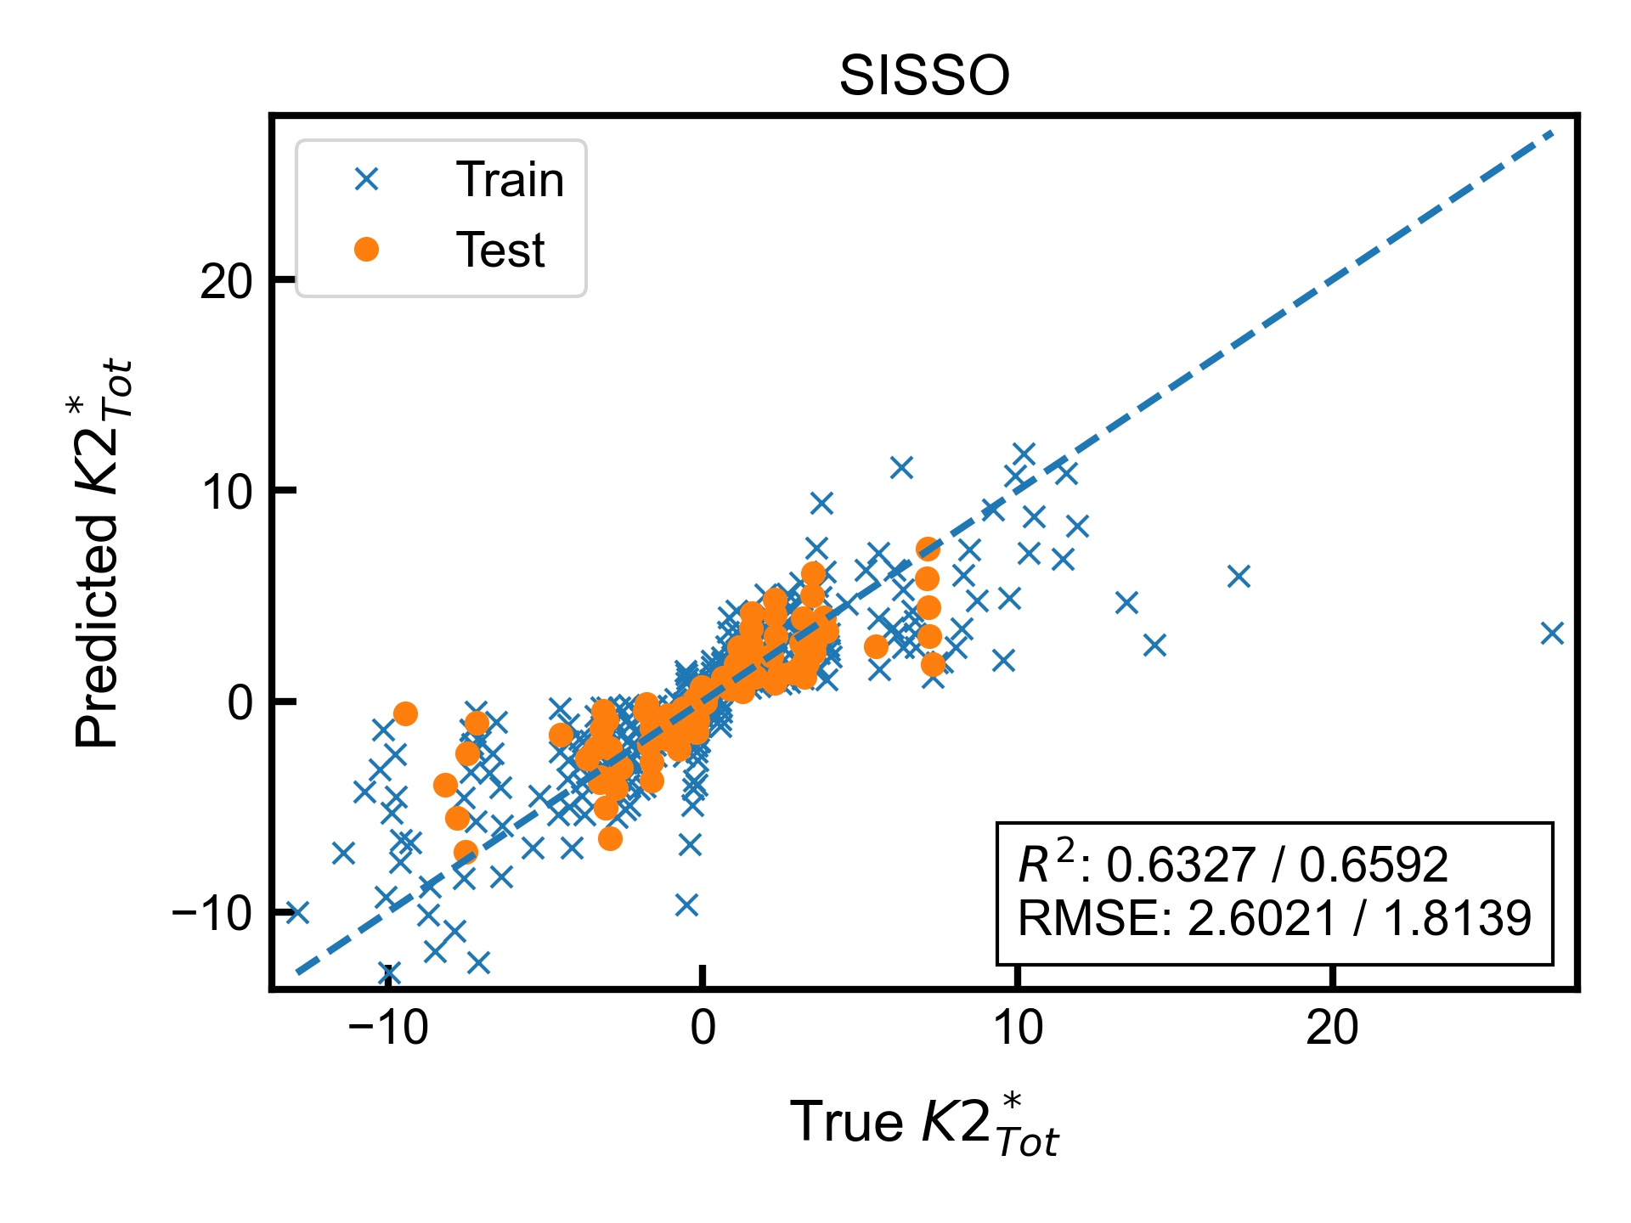
Application to stratified mxenes data($K_{Tot}^{2∗}$)
Applied best parameters from analysis to $K_{Tot}^{2∗}$ with stratification by material group.
Accuracy is high
Analytic Equation: $6215.127894\left[atomicstates∗\left(charge∗totelecpervolume\right)\right]−8.597285392[\left(c33∗charge\right)∗atomicstates]$

Slide 13
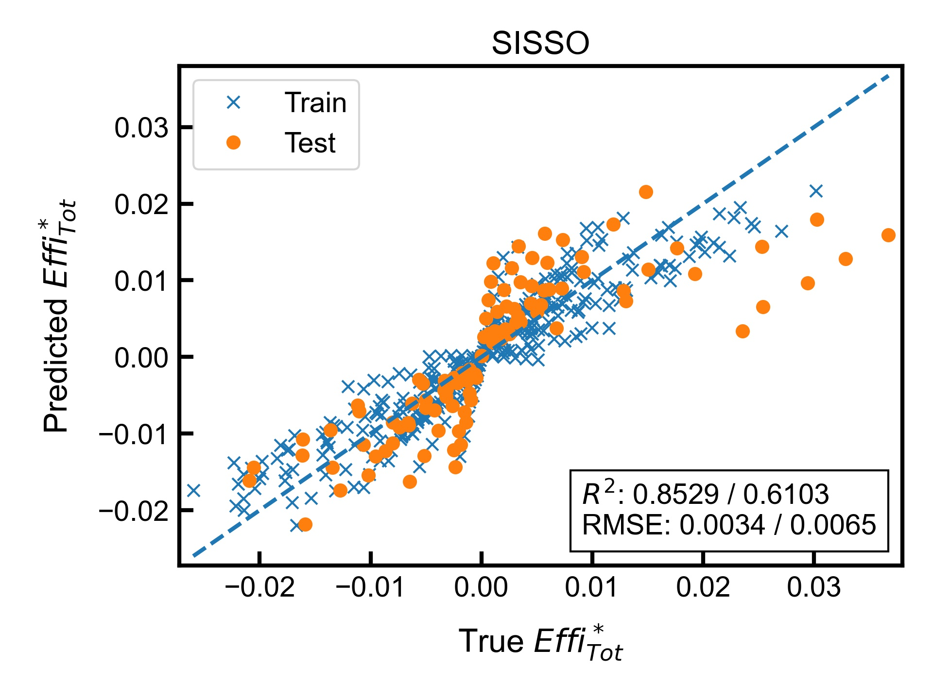
Application to stratified mxenes data(Efficiency)
Applied same parameters to predict effitotsigned with stratification by material group. (rung,maxcomp,dim = 2)
Accuracy is high
Analytic Equation: $0.3931274926\left[\left(charge∗atomic_tot_elec\right)−charge\right]+0.1873179569[charge∗(atomic_tot_elec−density)]$

Slide 14
SISSO-HEAS results analysis

Slide 15
Methodology
Selected target variable. (Elongation, YS, HV, UTS)
Used OMP on HEAS data to select 5 most correlated features.
Applied SISSO to the set of selected features, with hyperparameter tuning (range 1 to 3) and 5-fold cross-validation for rung, dimension and maximum complexity. (most frequent optimal combination of parameters: 1,2,1)
Repeated for HEAS data with only composition features and with only physical features to compare results.

Slide 16
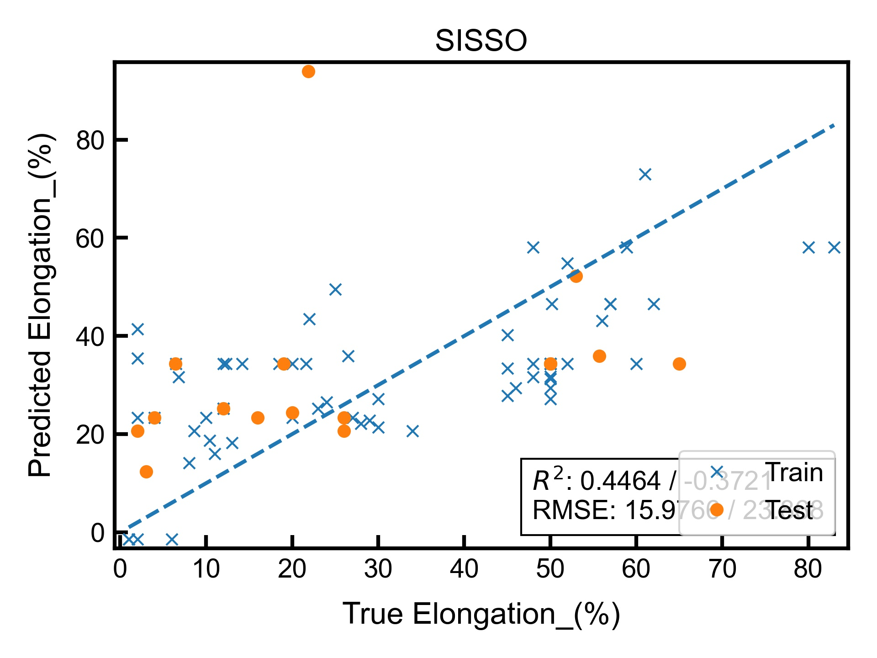
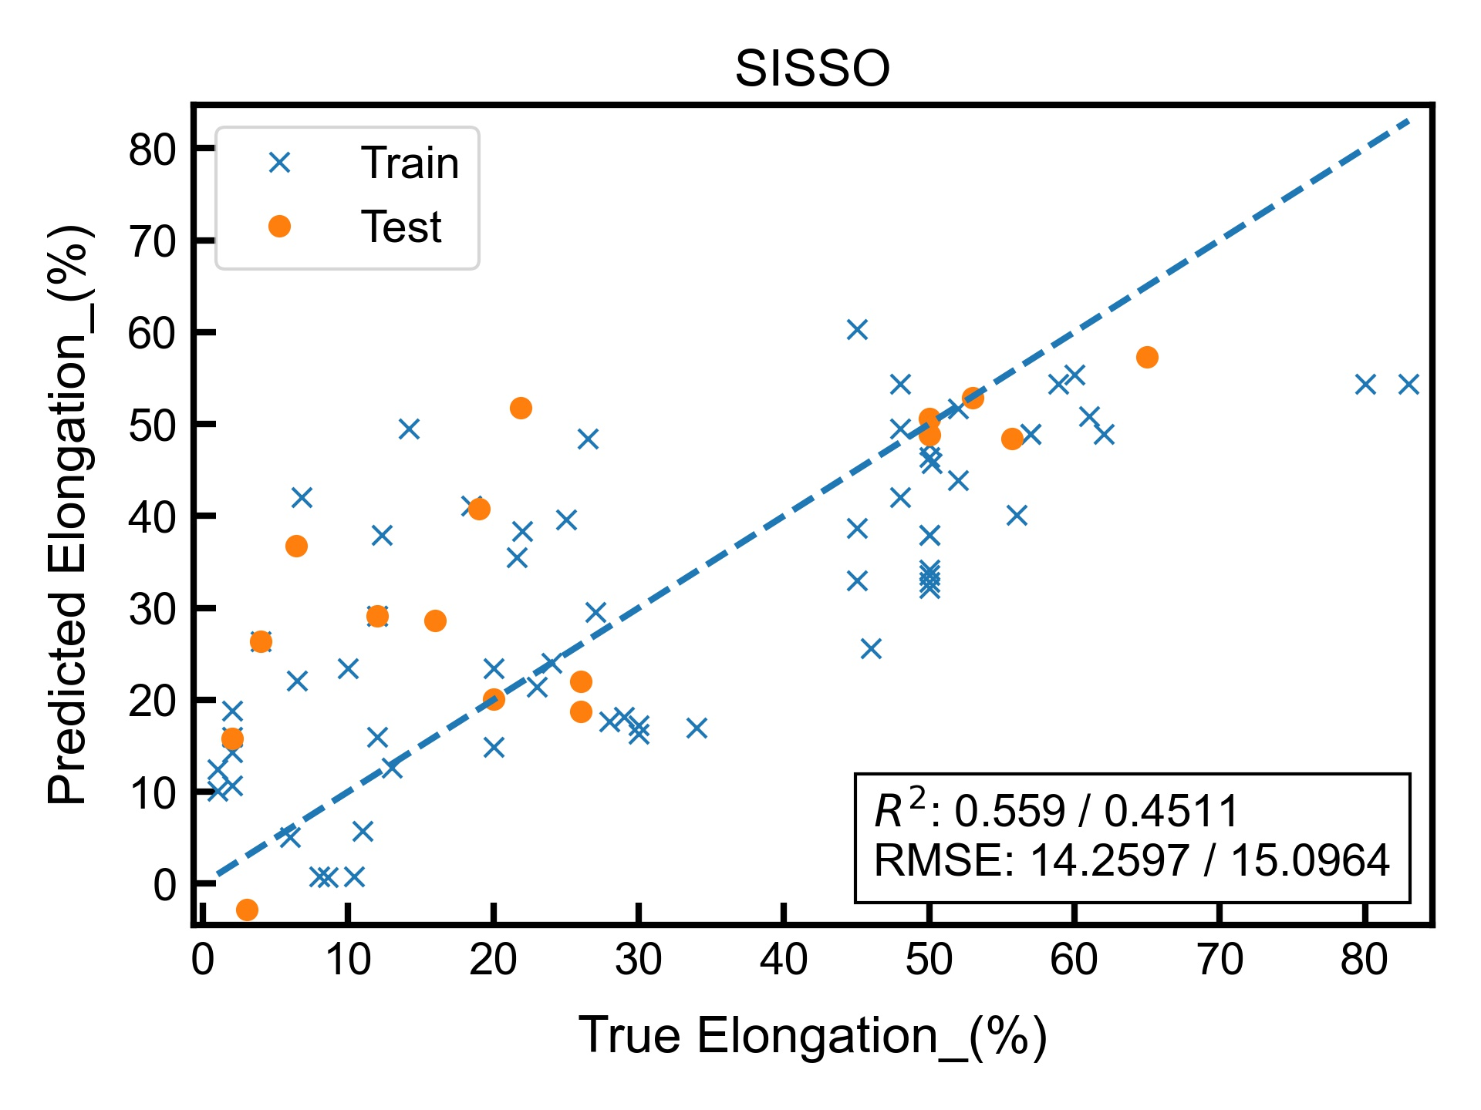
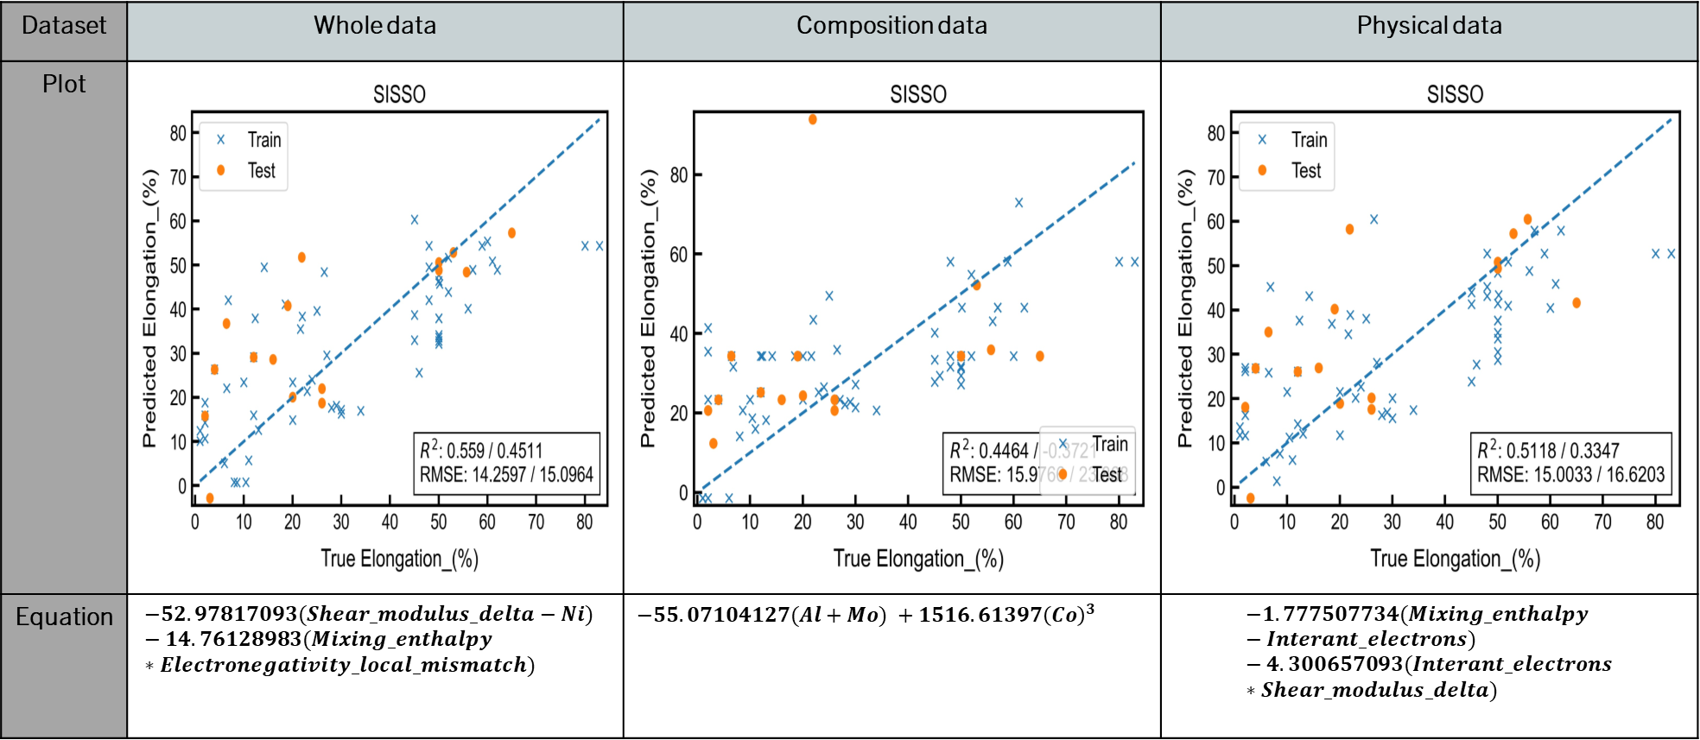
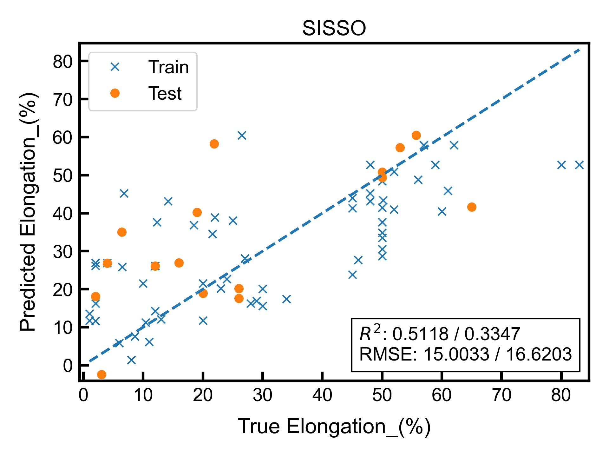
Target variable: Elongation(%)
Dataset | Whole data | Composition data | Physical data
Plot
Equation | $$−52.97817093(Shear_modulus_delta−Ni) −14.76128983(Mixing_enthalpy∗Electronegativity_local_mismatch)$$ | $−55.07104127(Al+Mo) +1516.61397{\left(Co\right)}^{3}$ | $$−1.777507734(Mixing_enthalpy−Interant_electrons) −4.300657093(Interant_electrons∗Shear_modulus_delta)$$
Accuracy (worst to best): Composition -> Physical -> Whole

Slide 17
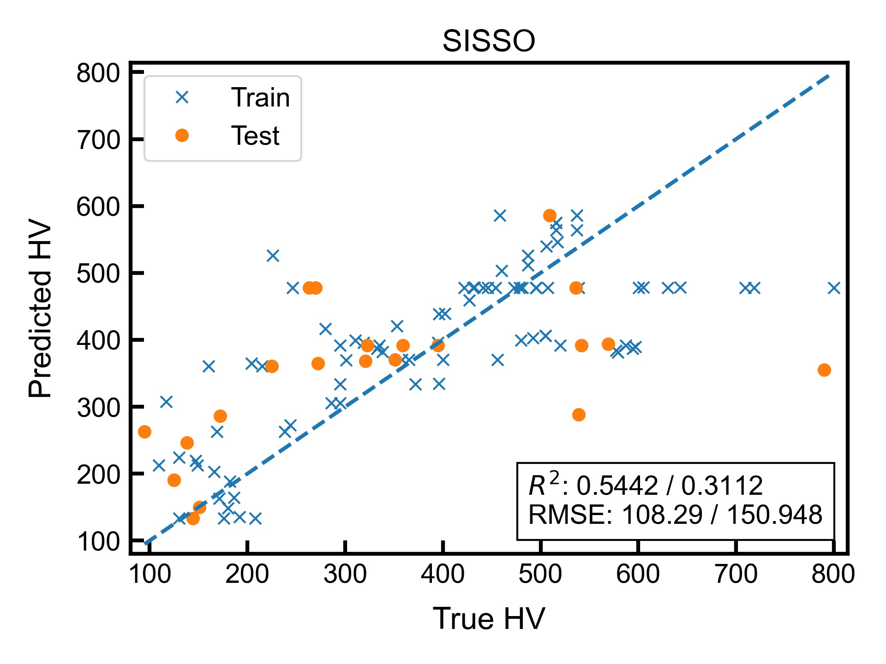
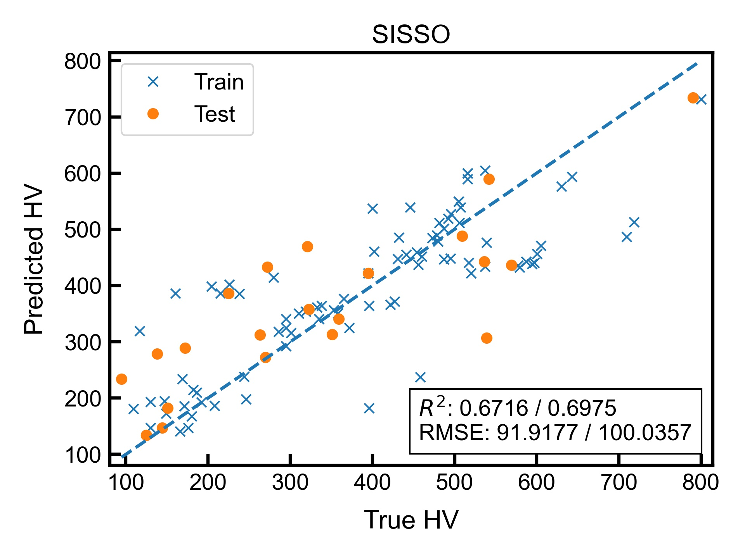
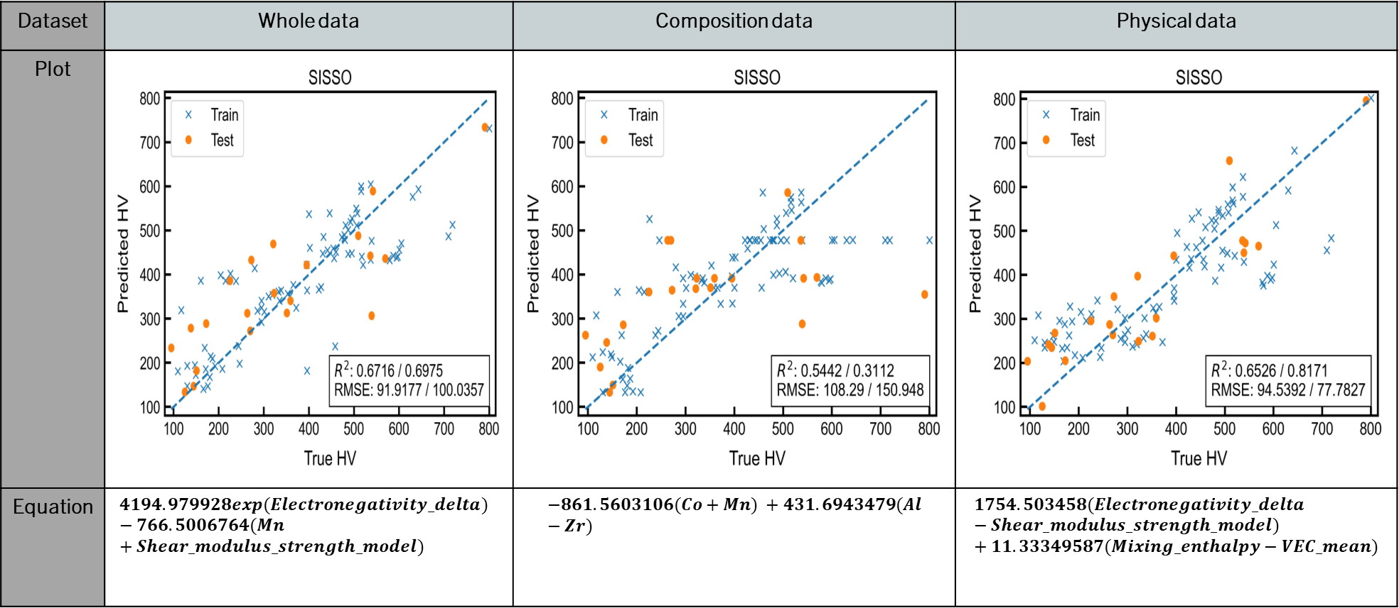
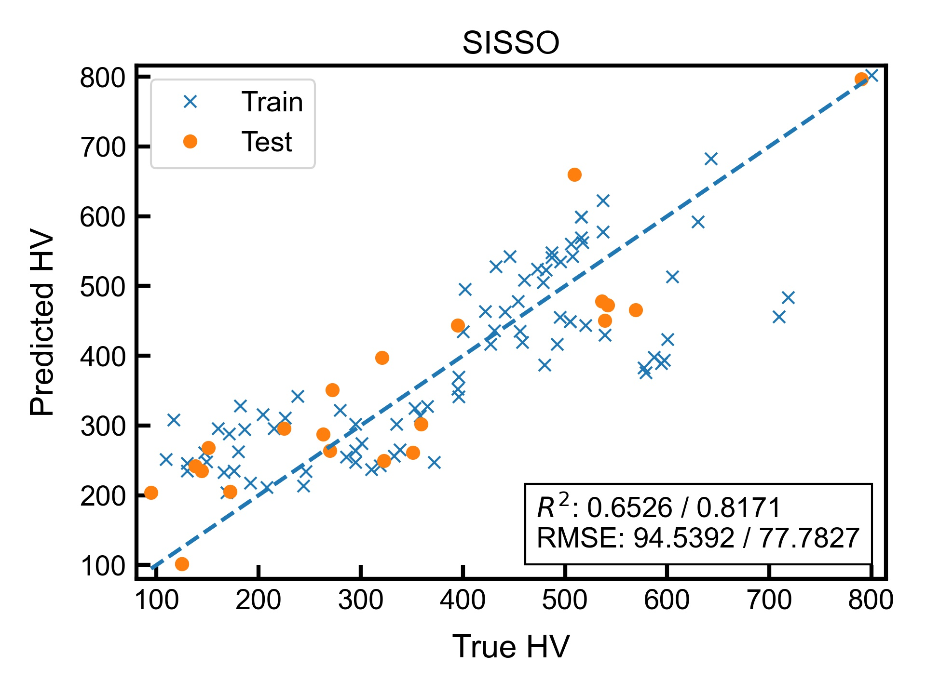
Target variable: hv
Dataset | Whole data | Composition data | Physical data
Plot
Equation | $$4194.979928exp(Electronegativity_delta) −766.5006764(Mn+Shear_modulus_strength_model)$$ | $$−861.5603106(Co+Mn) +431.6943479(Al−Zr)$$ | $$1754.503458(Electronegativity_delta−Shear_modulus_strength_model) +11.33349587(Mixing_enthalpy−VEC_mean)$$
Accuracy (worst to best): Composition -> Whole -> Physical

Slide 18
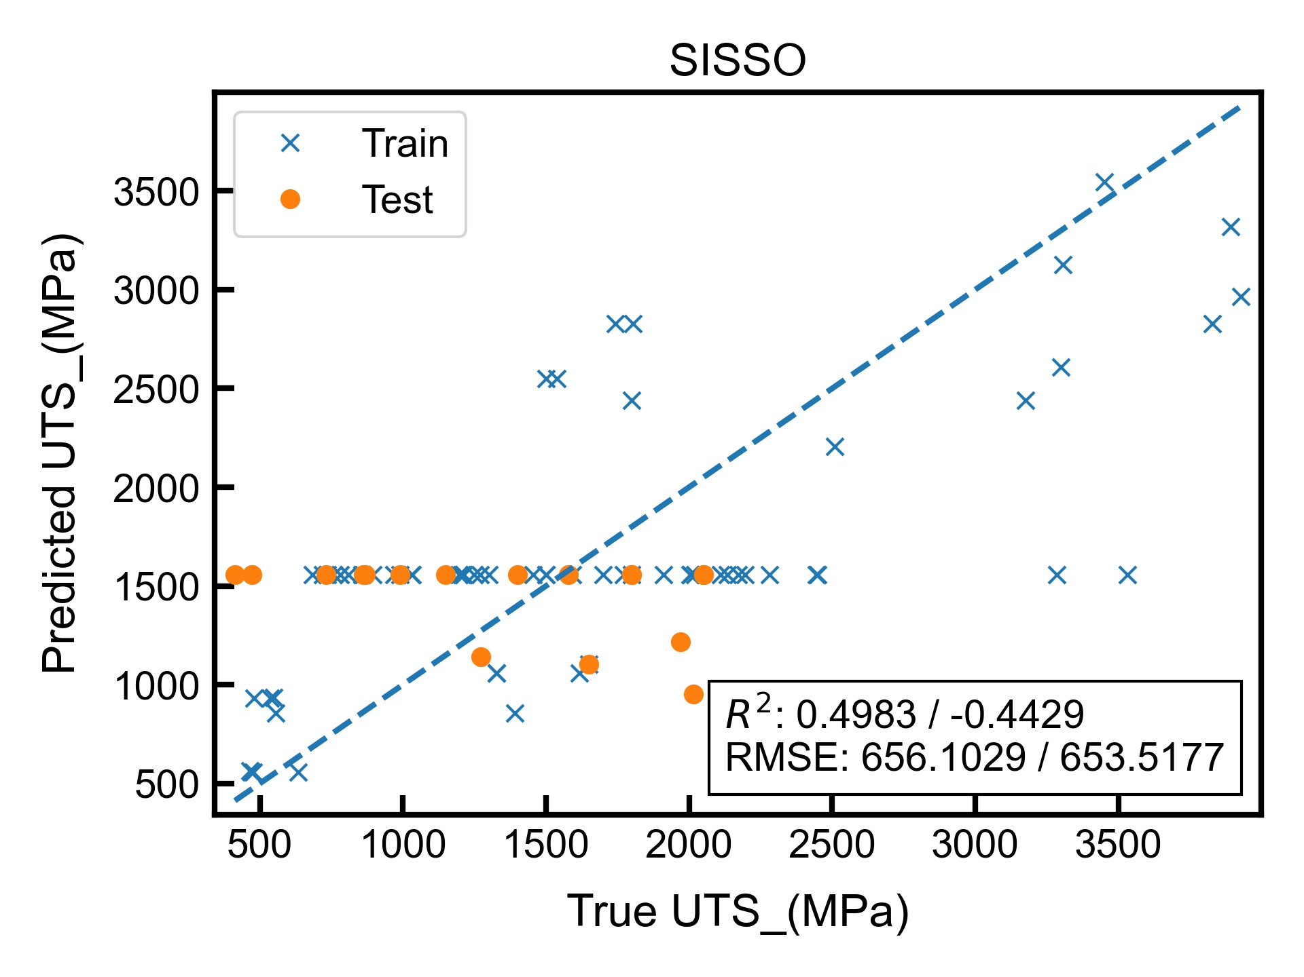
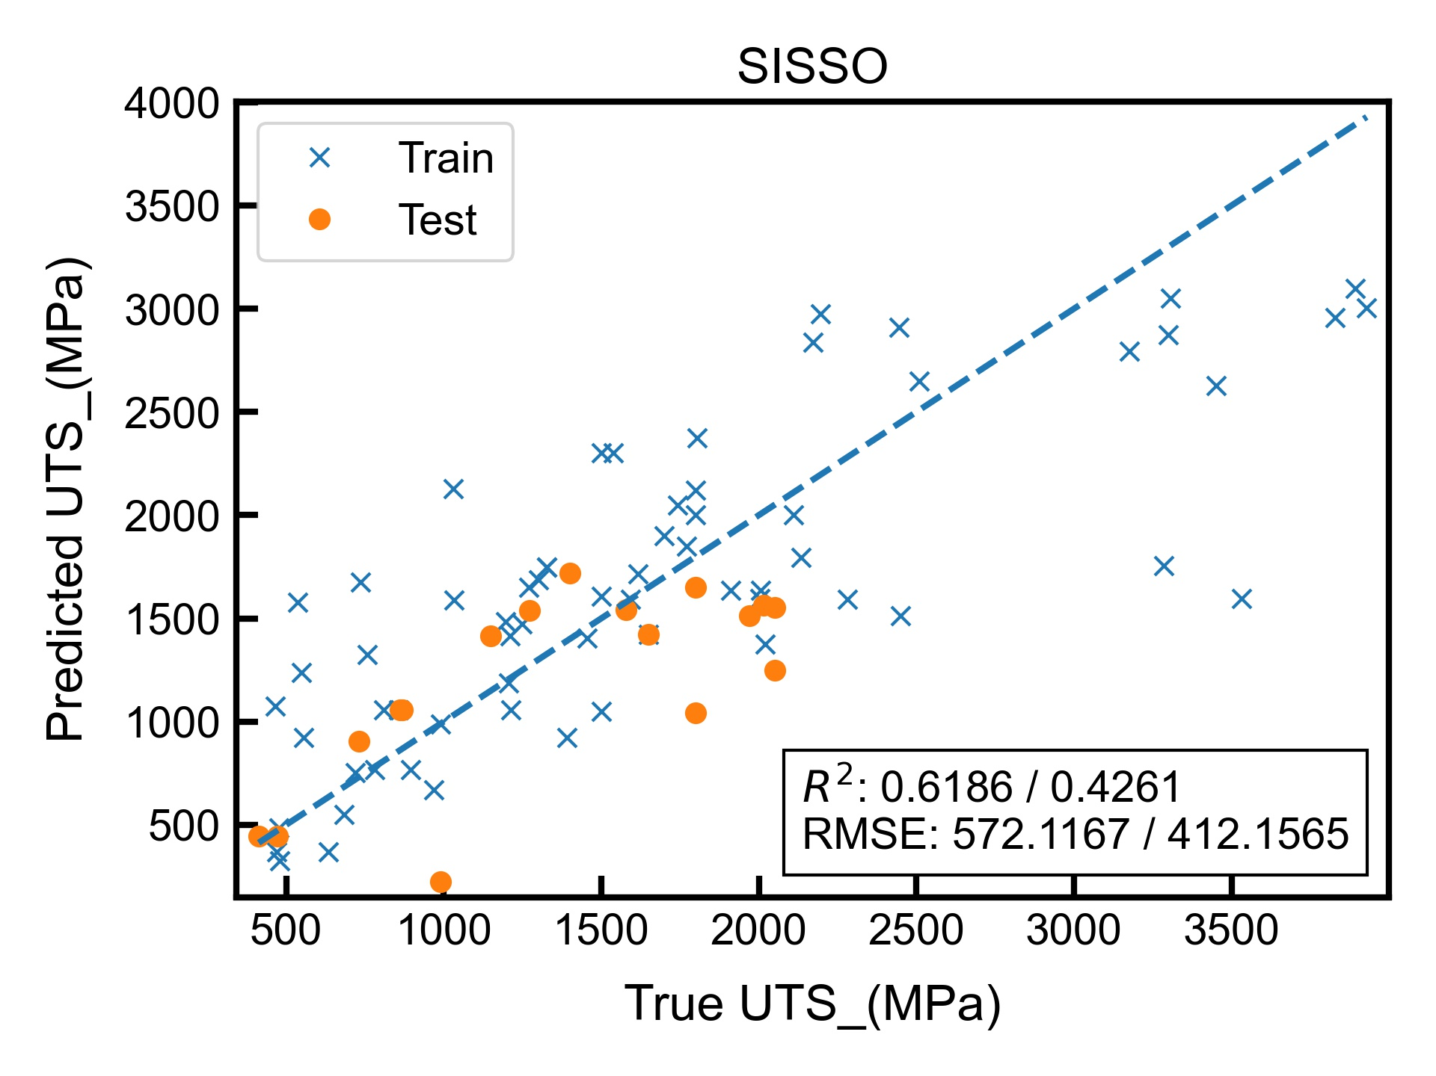
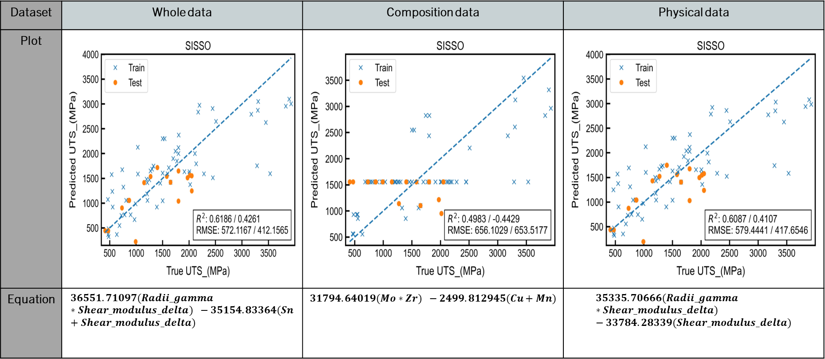

Target variable: UTS(MPA)
Dataset | Whole data | Composition data | Physical data
Plot
Equation | $$36551.71097(Radii_gamma∗Shear_modulus_delta) −35154.83364(Sn+Shear_modulus_delta)$$ | $$31794.64019(Mo∗Zr) −2499.812945(Cu+Mn)$$ | $$35335.70666(Radii_gamma∗Shear_modulus_delta) −33784.28339(Shear_modulus_delta)$$
Accuracy (worst to best): Composition -> Physical = Whole

Slide 19
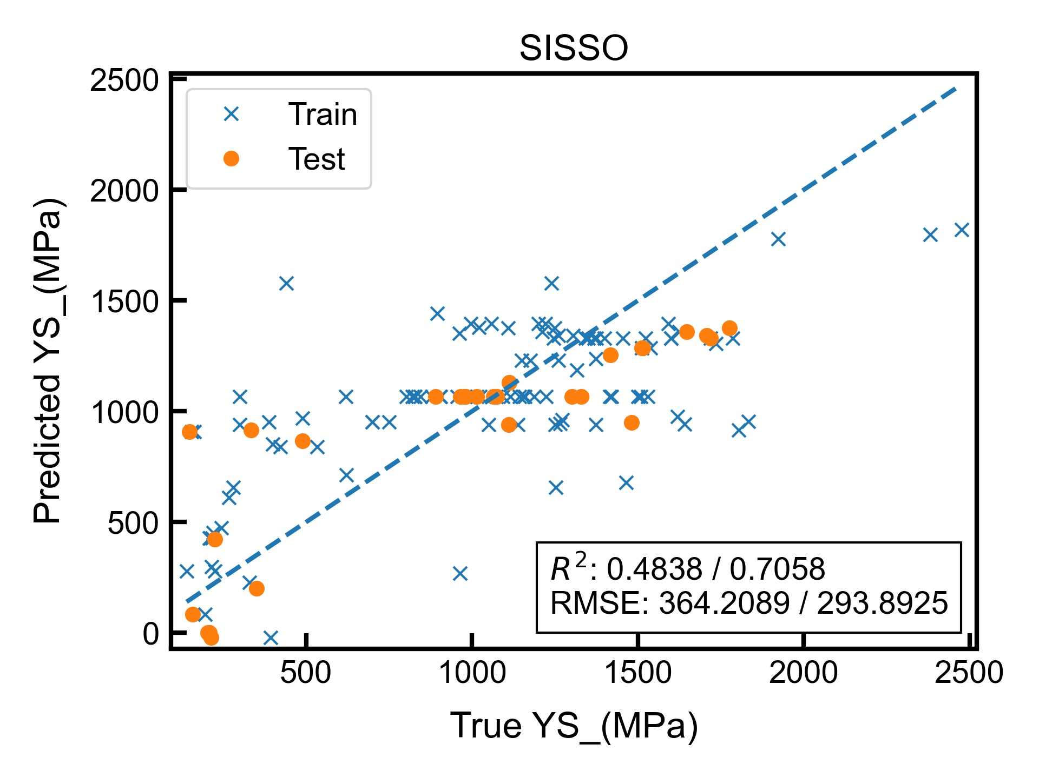
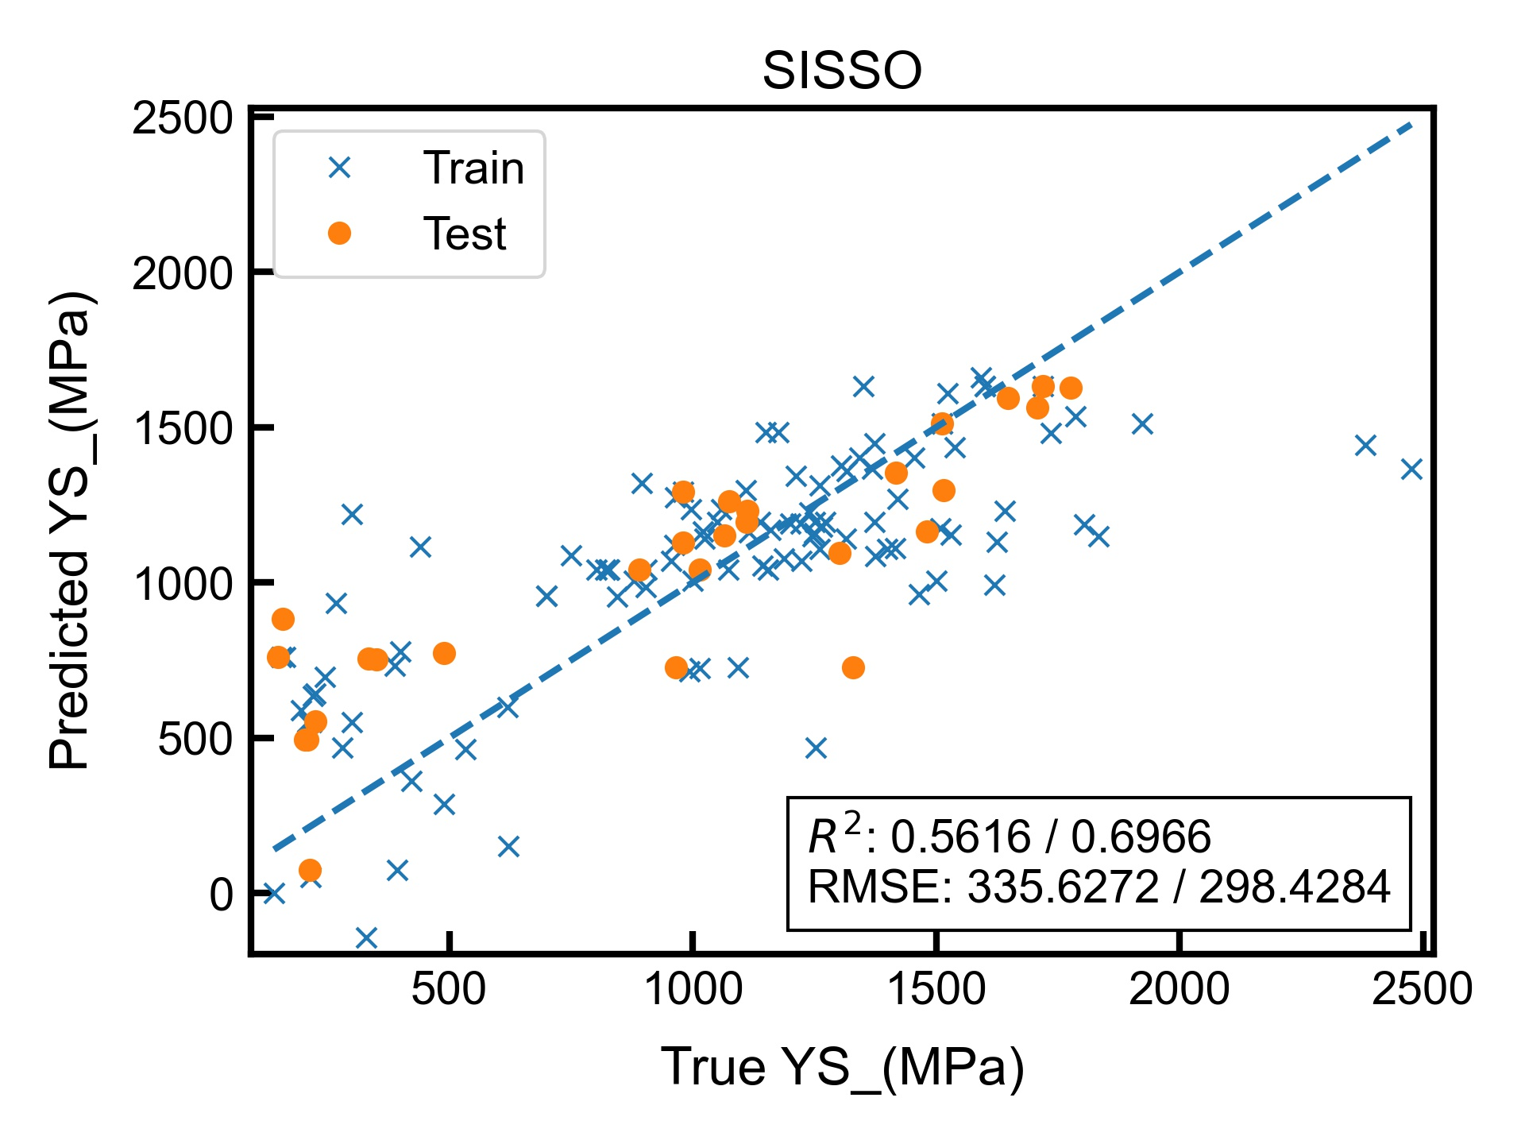
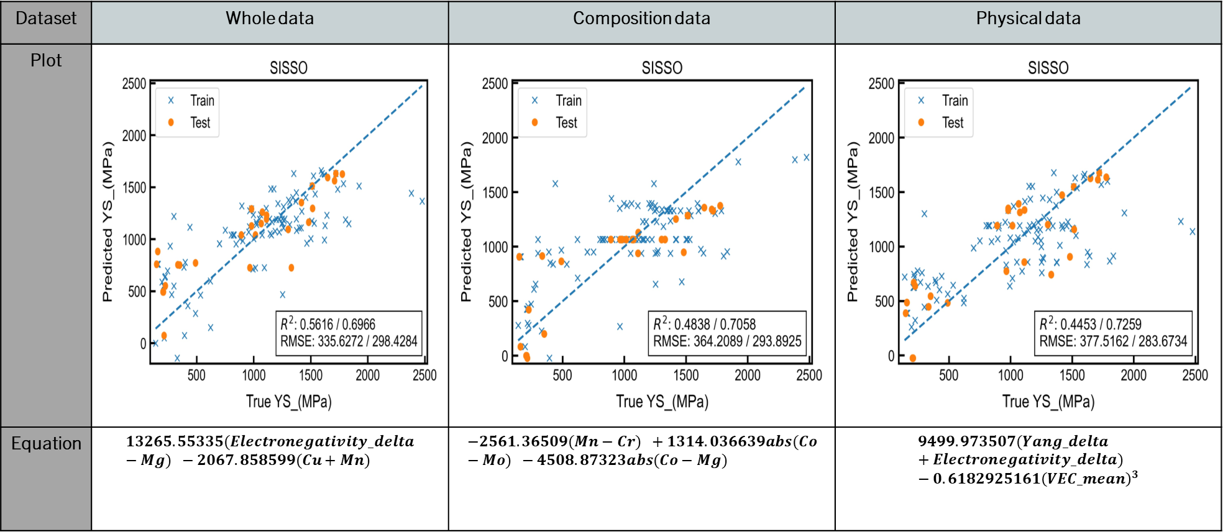
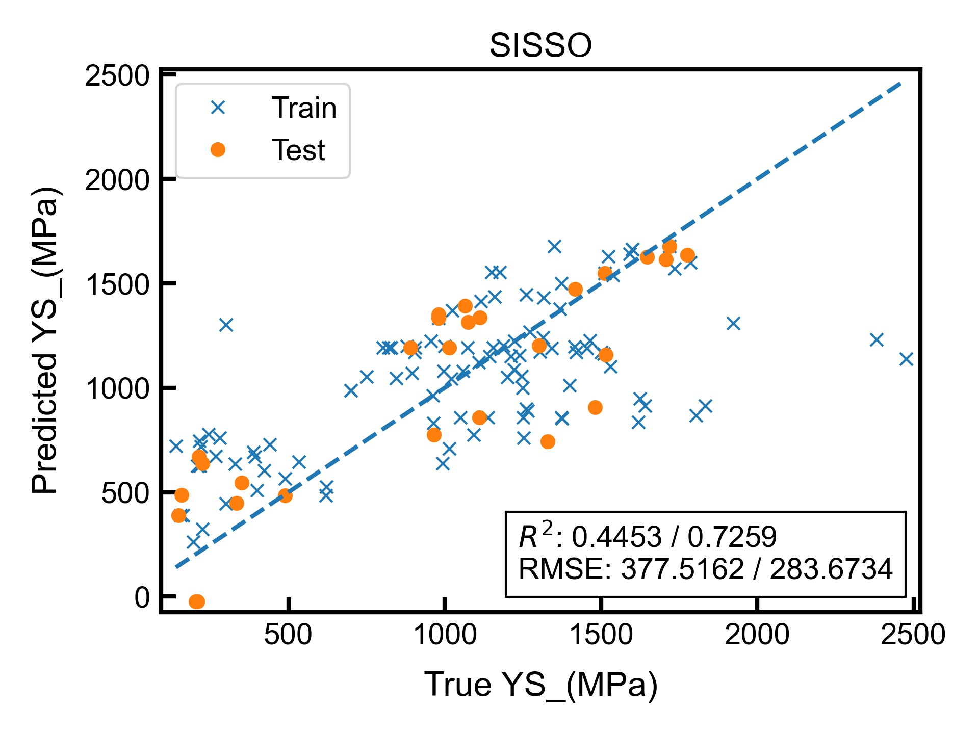
Target variable: ys(MPA)
Dataset | Whole data | Composition data | Physical data
Plot
Equation | $$13265.55335(Electronegativity_delta−Mg) −2067.858599(Cu+Mn)$$ | $$−2561.36509(Mn−Cr) +1314.036639abs(Co−Mo) −4508.87323abs(Co−Mg)$$ | $$9499.973507(Yang_delta+Electronegativity_delta) −0.6182925161{\left(VEC_mean\right)}^{3}$$
Accuracy (worst to best): Whole -> Composition -> Physical

Slide 20
Notable results
For all targets, using only composition data was less accurate than only physical data.
For targets HV, YS, whole data was less accurate than only physical. This implies that adding composition data as predictors reduced the overall accuracy.
Only for target Elongation, whole data was more accurate than physical. This implies that composition data helped improve accuracy.
For target YS, composition features made up a larger proportion of the features used in whole data compared to other targets. (3 comp. and 1 phy. feat. vs 1 comp. and 3 phy. feat.) However, using whole data performed worse than composition or physical data only in this case.

Slide 21
Multi-task sisso

Slide 22
overview
Takes as inputs, “X” data columns and multiple “Y” target columns.
For each feature (variable in the equation), single-task SISSO is run for each individual “Y” target column.
RMSE for that feature is calculated as the average RMSE of each single task run, and the features which minimise RMSE are selected for usage in the equation.
Generates analytic equation for each target, with a fixed set of features. i.e. All targets share the same features but with different coefficients in their equations.
Advantages: Predictions are generated for NA values.

Slide 23
Application to heas dataset
“Y” target variables are input as 'YS (MPa)', ’HV’ and 'UTS (MPa)’.
Performed with only physical data.
Run with configuration rung = 2, dimension = 2 and complexity 2.
Run with configuration rung = 1, dimension = 2 and complexity 1.
Compared with previous results with optimal config:1,2,1 for config:1,2,1.

Slide 24
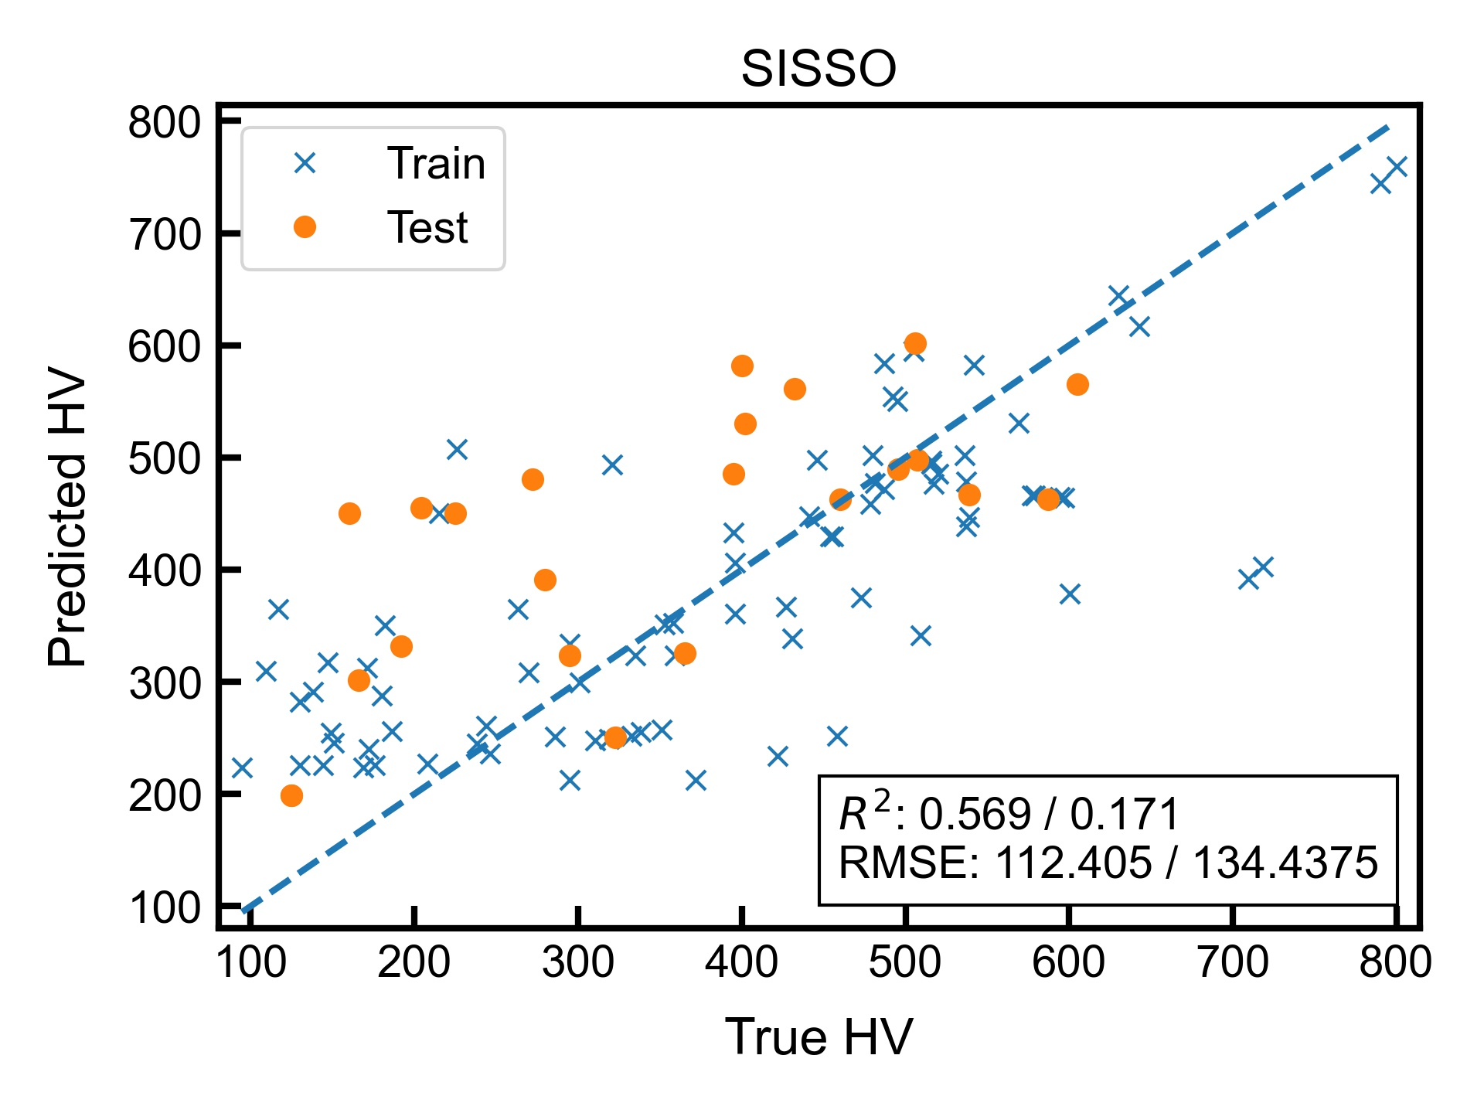
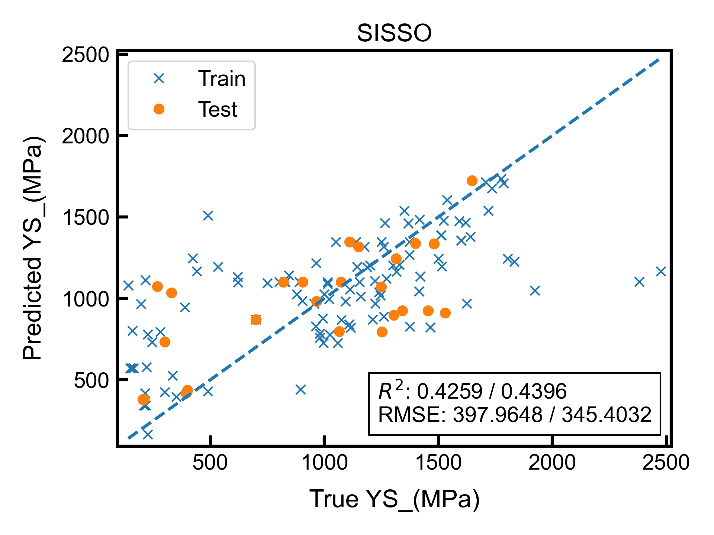
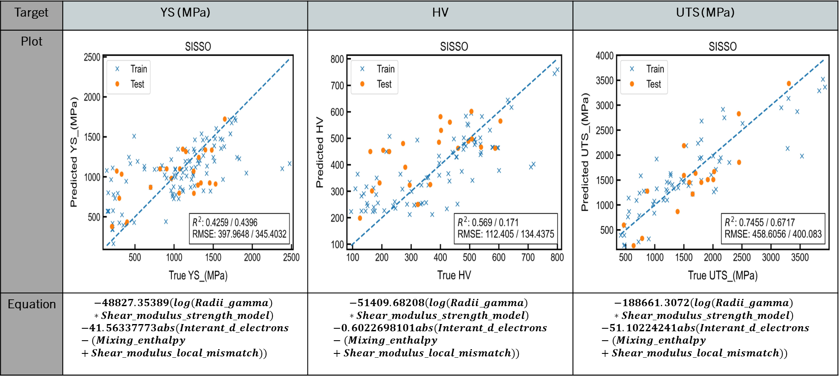
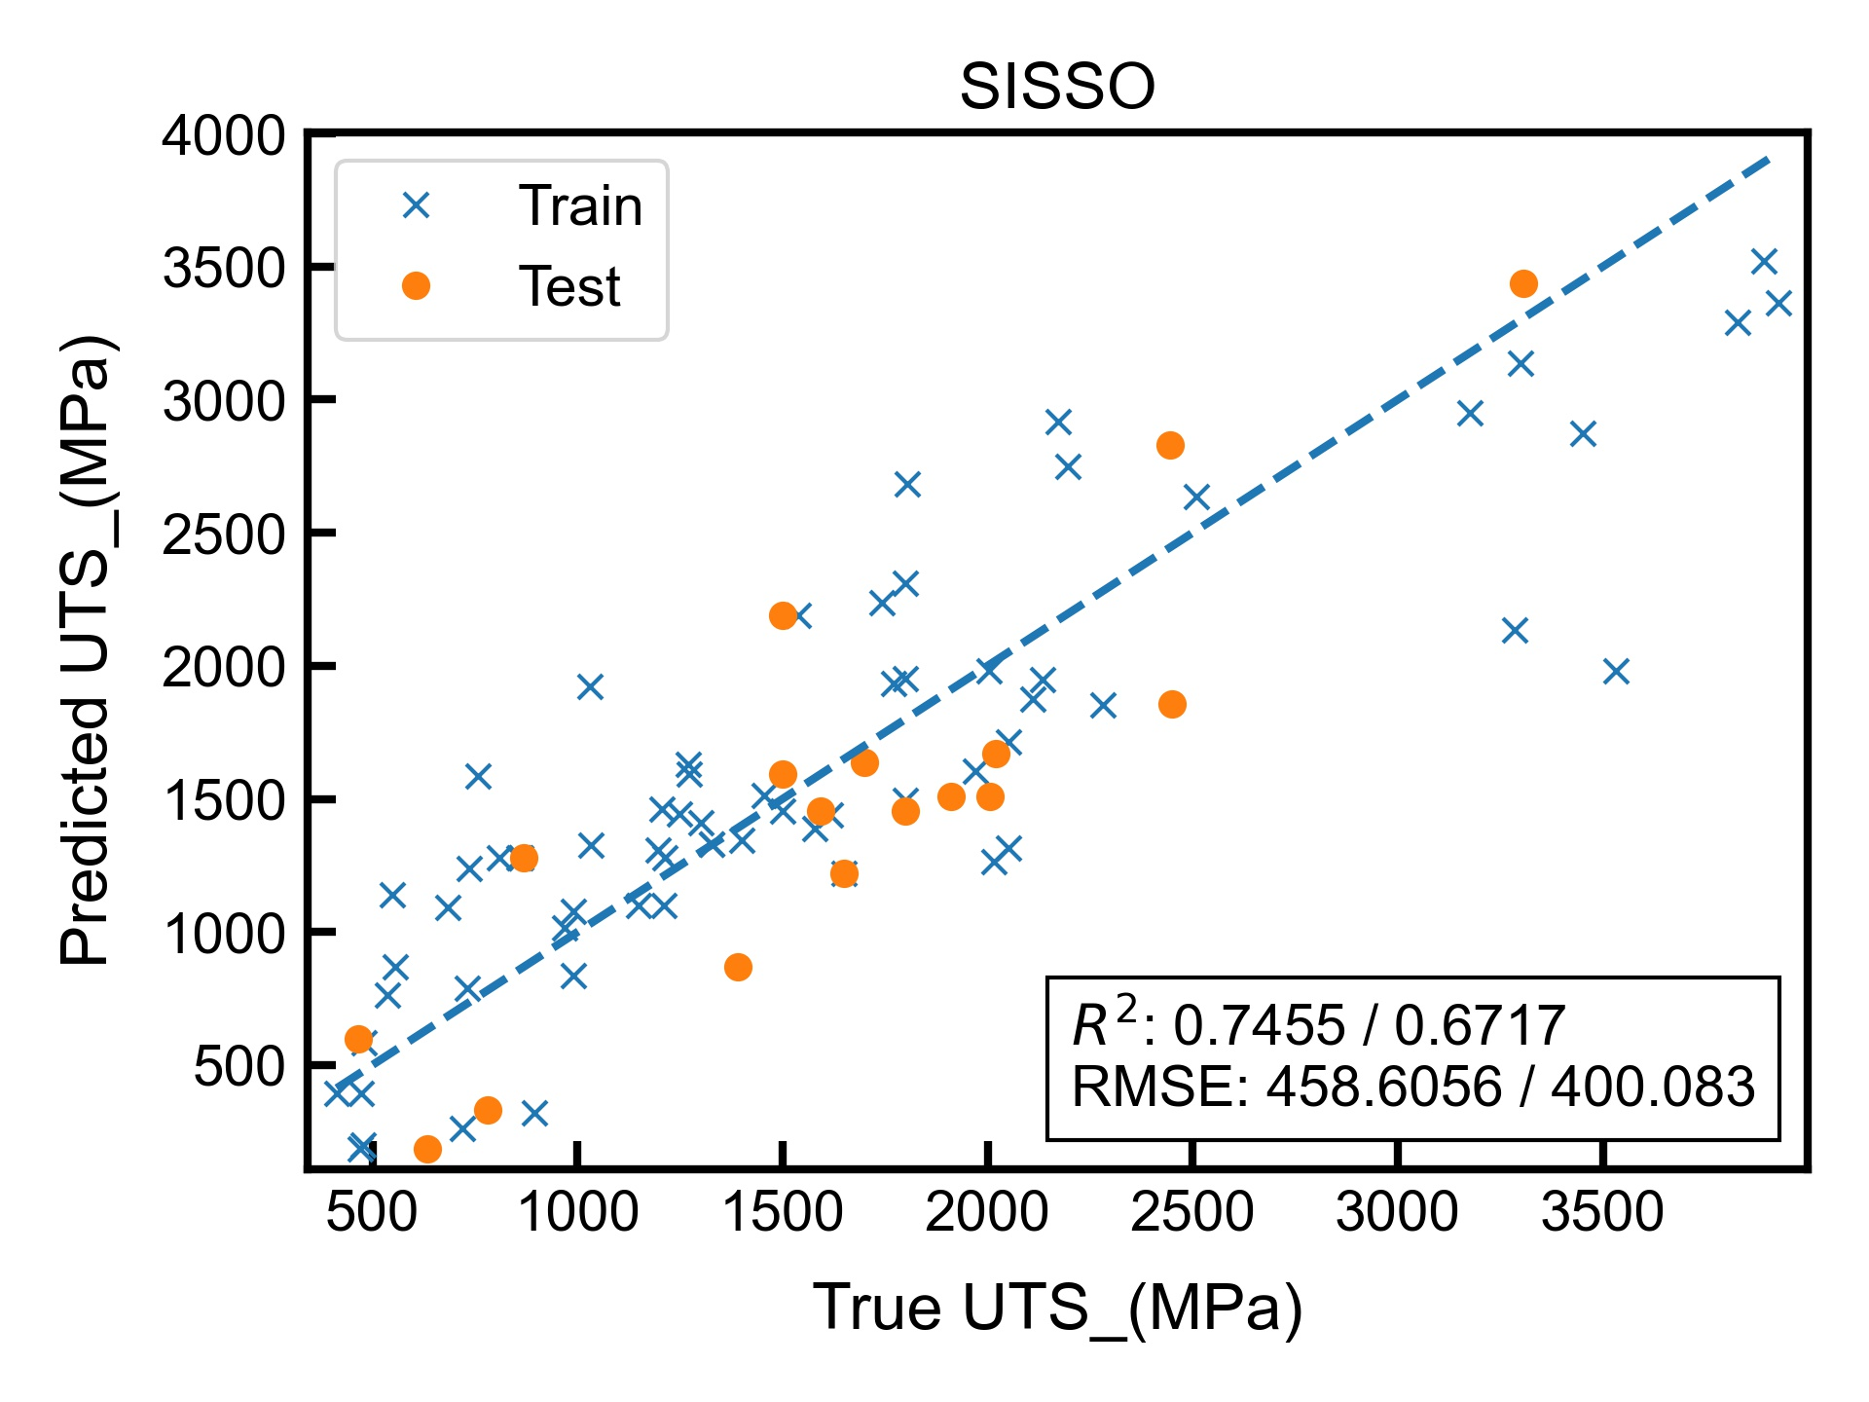
Config: rung=2,dim=2,comp=2
Target | YS (MPa) | HV | UTS (MPa)
Plot
Equation | $$−48827.35389\left(log\left(Radii_gamma\right)∗Shear_modulus_strength_model\right)$$ $$−41.56337773abs(Interant_d_electrons−(Mixing_enthalpy+Shear_modulus_local_mismatch))$$ | $$−51409.68208\left(log\left(Radii_gamma\right)∗Shear_modulus_strength_model\right)$$ $$−0.6022698101abs(Interant_d_electrons−(Mixing_enthalpy+Shear_modulus_local_mismatch))$$ | $$−188661.3072\left(log\left(Radii_gamma\right)∗Shear_modulus_strength_model\right)$$ $$−51.10224241abs(Interant_d_electrons−(Mixing_enthalpy+Shear_modulus_local_mismatch))$$

Slide 25
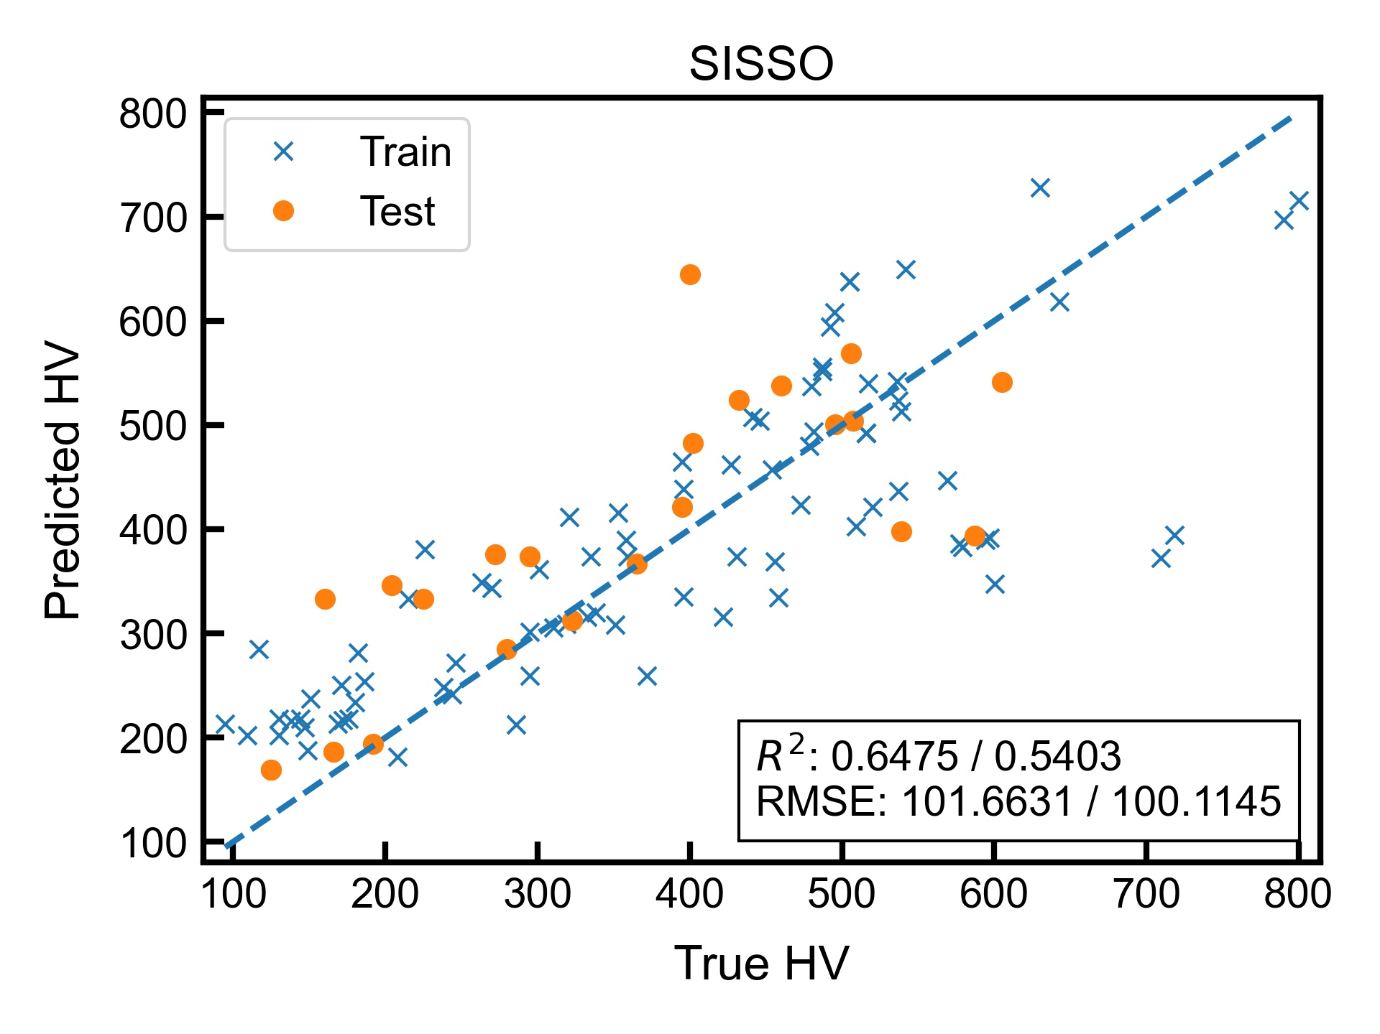
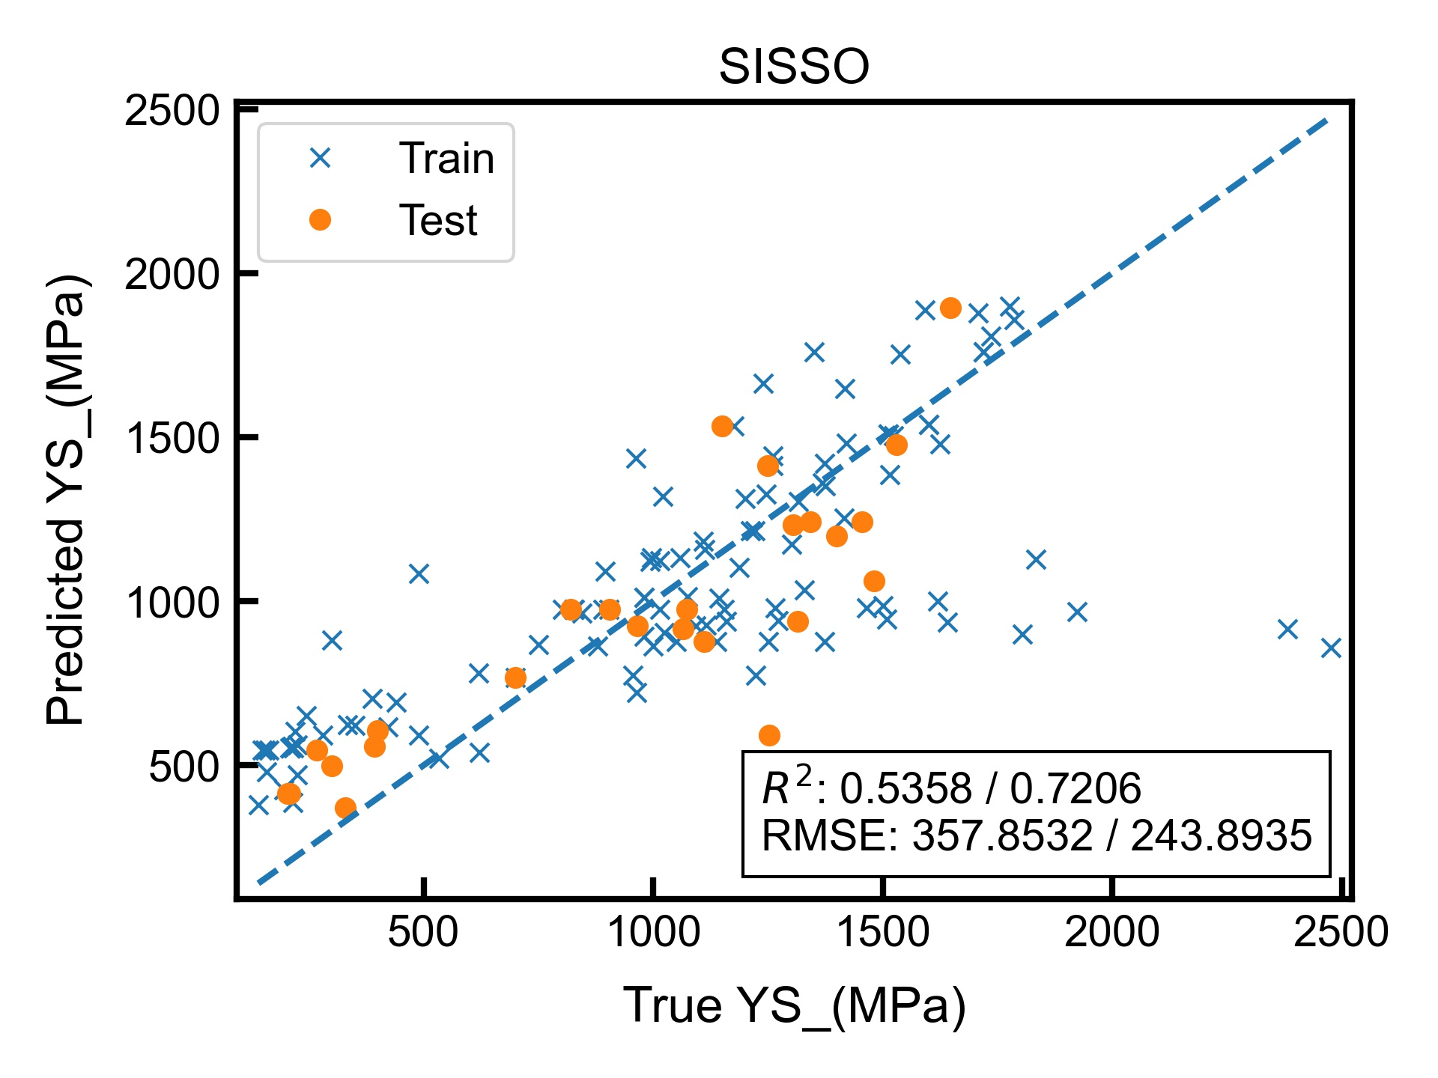
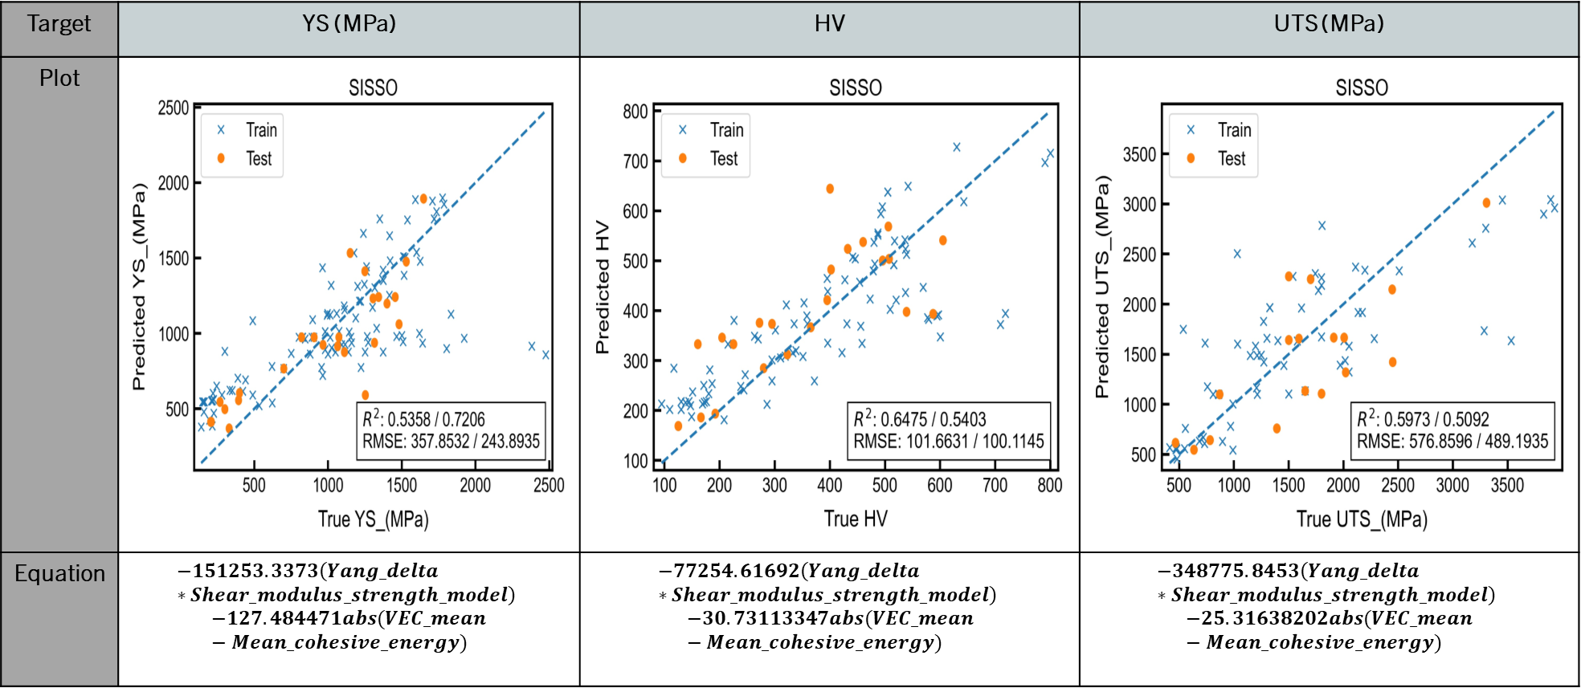
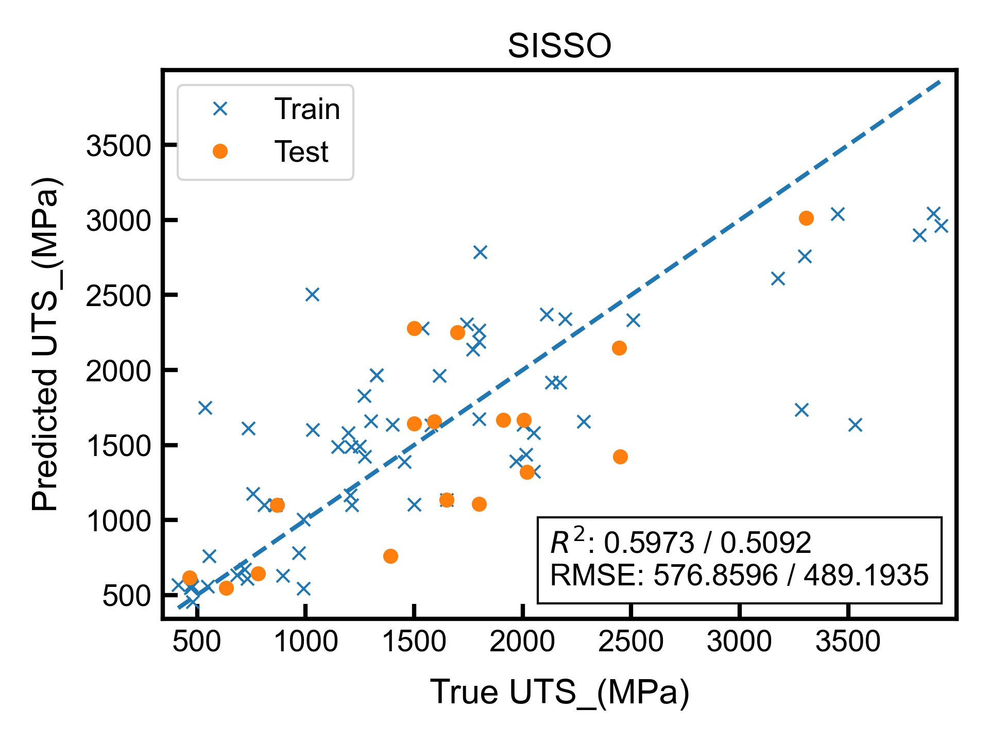
Config: rung=1,dim=2,comp=1
Target | YS (MPa) | HV | UTS (MPa)
Plot
Equation | $$−151253.3373\left(Yang_delta∗Shear_modulus_strength_model\right)$$ $$−127.484471abs(VEC_mean−Mean_cohesive_energy)$$ | $$−77254.61692\left(Yang_delta∗Shear_modulus_strength_model\right)$$ $$−30.73113347abs(VEC_mean−Mean_cohesive_energy)$$ | $$−348775.8453\left(Yang_delta∗Shear_modulus_strength_model\right)$$ $$−25.31638202abs(VEC_mean−Mean_cohesive_energy)$$

Slide 26
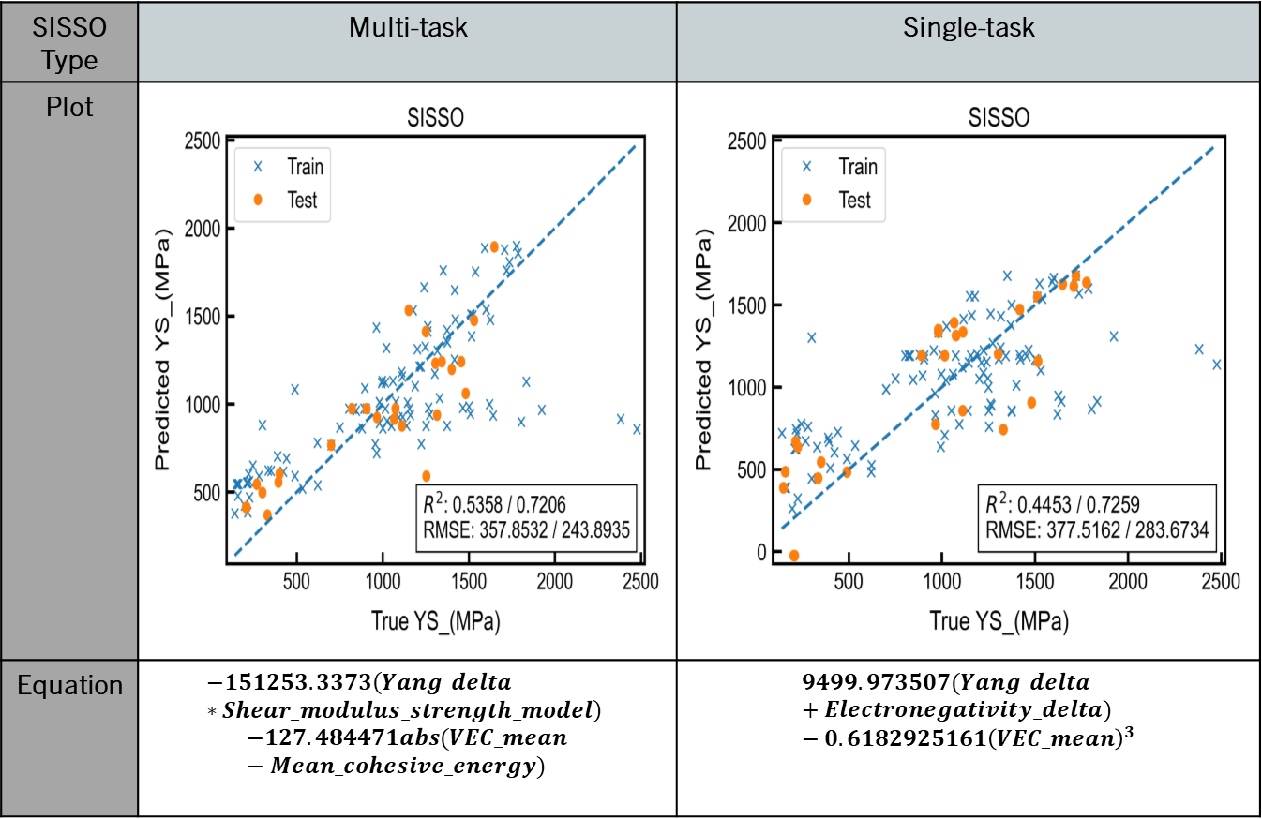
Comparison: Ys(MPA)
Configuration: 1,2,1 is used for both.
Multi-task performs better in comparison to single-task.
YS data has 56 nan values out of 193. i.e. 29% nan values.
SISSO Type | Multi-task | Single-task
Plot
Equation | $$−151253.3373\left(Yang_delta∗Shear_modulus_strength_model\right)$$ $$−127.484471abs(VEC_mean−Mean_cohesive_energy)$$ | $$9499.973507(Yang_delta+Electronegativity_delta) −0.6182925161{\left(VEC_mean\right)}^{3}$$

Slide 27
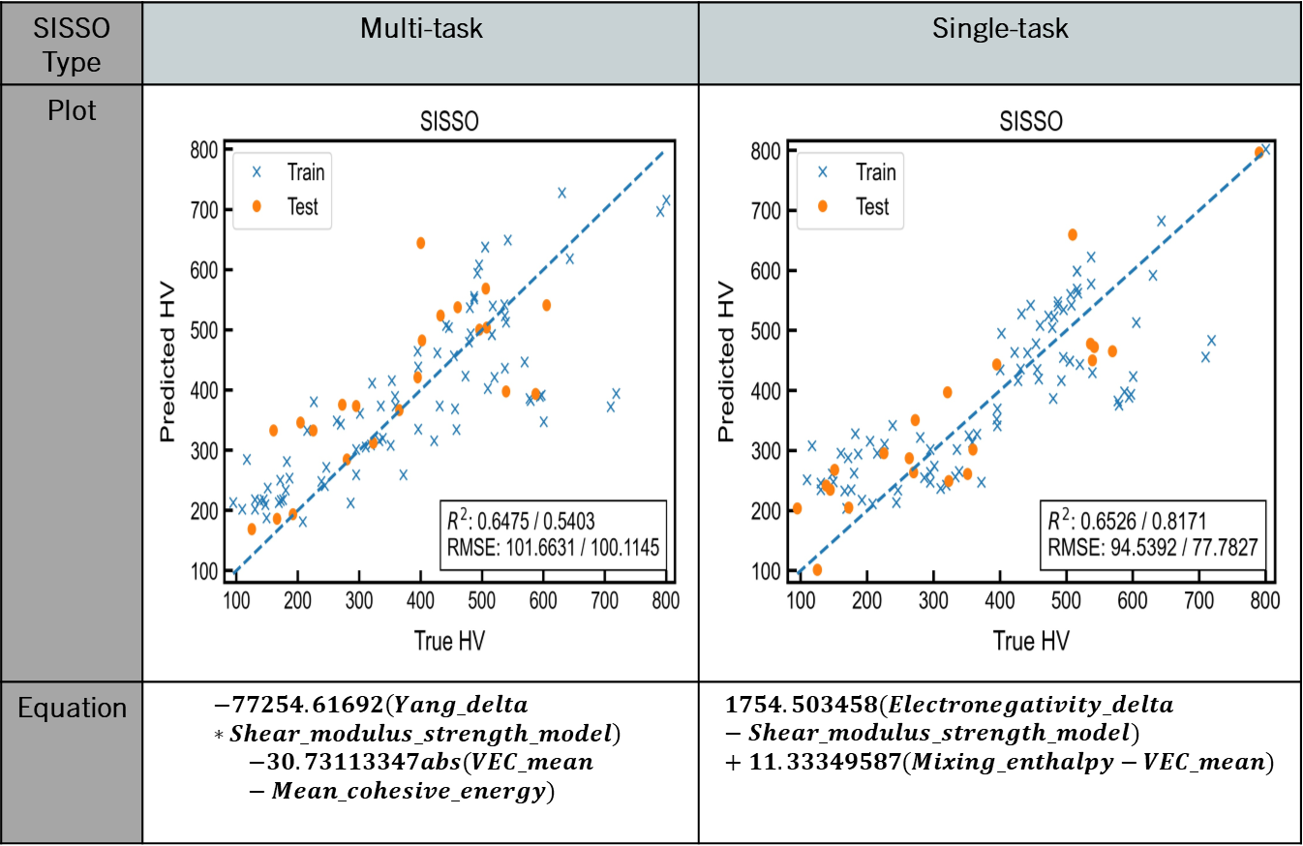
Comparison:
hv
Configuration: 1,2,1 is used for both.
Multi-task performs worse in comparison to single-task.
HV data has 86 nan values out of 193 entries. i.e. 44.5% nan values.
SISSO Type | Multi-task | Single-task
Plot
Equation | $$−77254.61692\left(Yang_delta∗Shear_modulus_strength_model\right)$$ $$−30.73113347abs(VEC_mean−Mean_cohesive_energy)$$ | $$1754.503458(Electronegativity_delta−Shear_modulus_strength_model) +11.33349587(Mixing_enthalpy−VEC_mean)$$

Slide 28
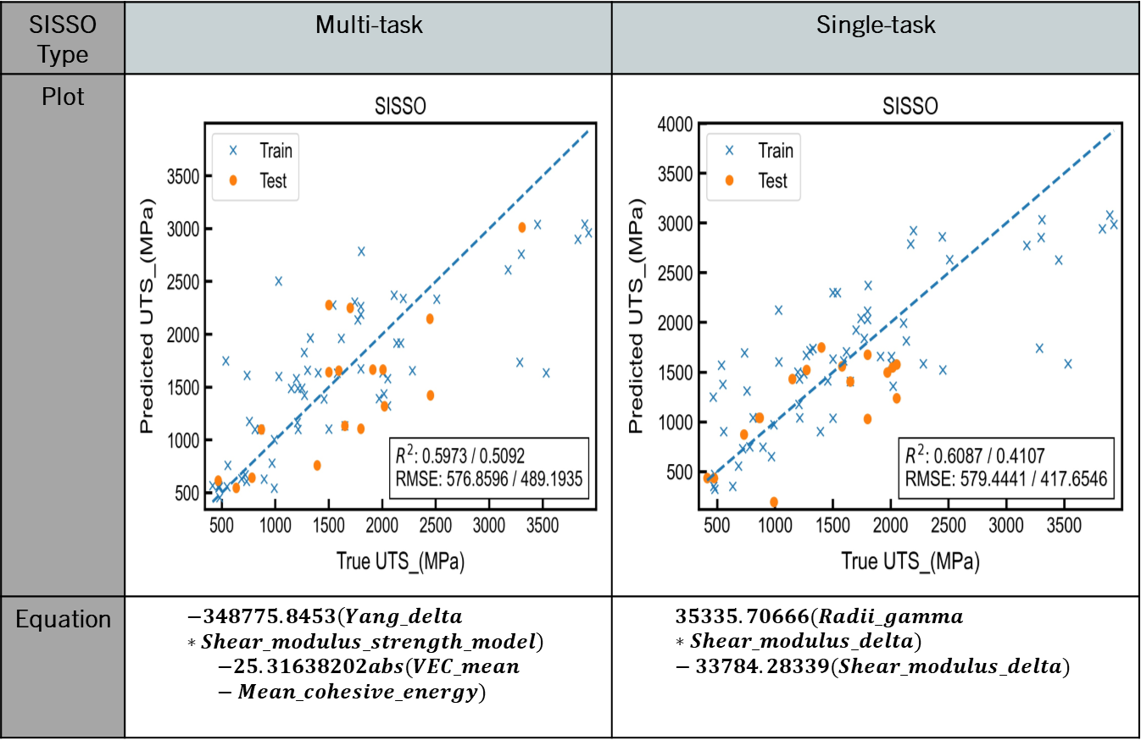
Comparison:
Uts(MPA)
Configuration: 1,2,1 is used for both.
Multi-task performs worse in comparison to single-task.
UTS data has 111 nan values out of 193 entries. i.e. 57.5% nan values.
SISSO Type | Multi-task | Single-task
Plot
Equation | $$−348775.8453\left(Yang_delta∗Shear_modulus_strength_model\right)$$ $$−25.31638202abs(VEC_mean−Mean_cohesive_energy)$$ | $$35335.70666(Radii_gamma∗Shear_modulus_delta) −33784.28339(Shear_modulus_delta)$$

Slide 29
Notable results
It can be inferred that multi-task performance is close to single-task.
It appears that columns with fewer missing entries benefit more from multi-task SISSO.
Similarly, it appears that columns with more missing entries lose accuracy from using multi-task SISSO. It could be that the larger target datasets corrupt the accuracy by holding a larger influence on the selection of features.
It is to be noted for the comparison that multi-task had been run without OMP (with multiple targets, it might not be possible to specify correlation in the given software) and without cross-validation (due to software limitations). Having both would further help validate the hypotheses above as single-task had been run with both.

